Slide 1


Slide 2
Annual, event-based strategic planning is dead.
Build. Launch. Leave.
It’s not working.
Notes:
Key Message: Transition slide – we’ve talked a little bit about the four core practice areas for creating sustainable growth and impact. We’re going to spend a little time going deeper into each.
Transition: “As we’ve talked about already, sustainability of growth and impact is key – here’s how we do it.”

Slide 3

“Many studies have concluded that the vast majority of strategic planning fails, up to 67 percent actually.
In part, it’s because the traditional way of thinking about strategic planning is totally backward.”
Notes:
Key Message: Transition slide – we’ve talked a little bit about the four core practice areas for creating sustainable growth and impact. We’re going to spend a little time going deeper into each.
Transition: “As we’ve talked about already, sustainability of growth and impact is key – here’s how we do it.”

Slide 4

So, how do you make sure your clients are here…
and not over here?
Agile Strategy
Traditional Planning
Notes:
DELETE?

Slide 5
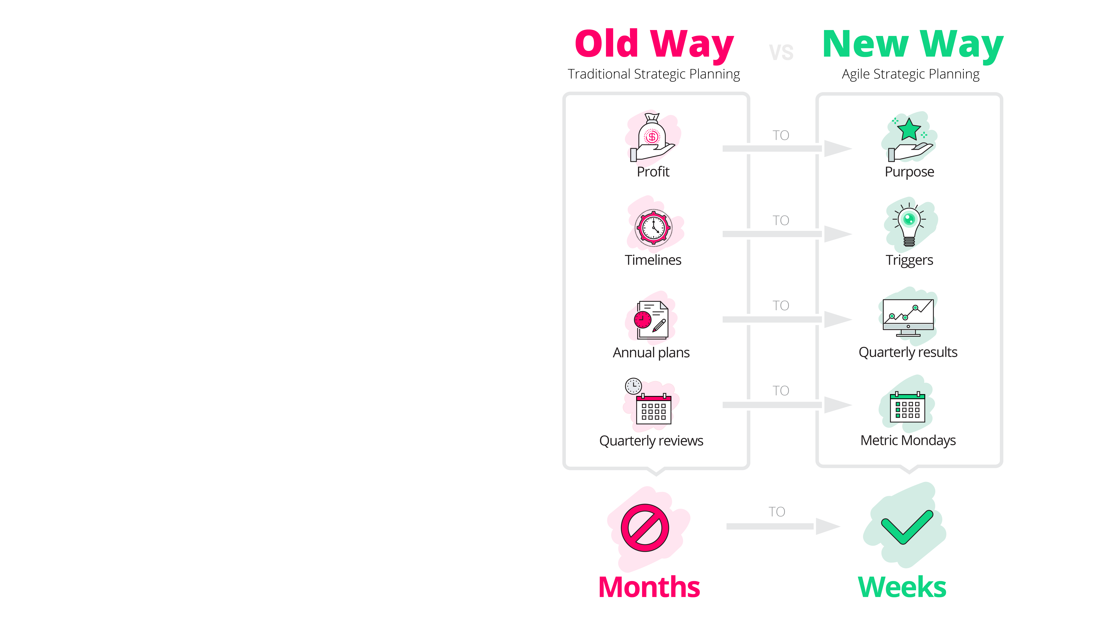
This shift to agile strategy has changed the game — for you, and for your clients.
Notes:
DELETE?

Slide 6
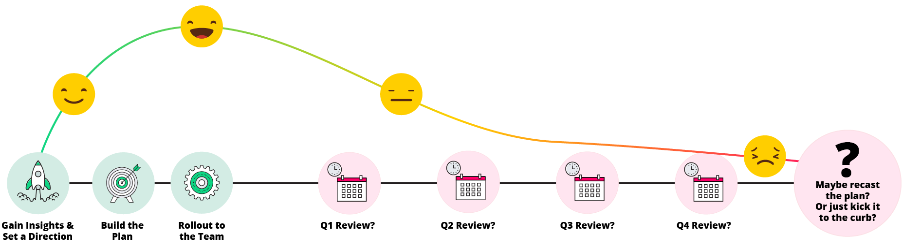
Here’s how the traditional cycle shakes out.
You build an
awesome plan
You roll it out with spreadsheets, and hope the client stays engaged and focused
Engagement falls
You hope they come back next year
Notes:
Key Message: Grounding slide on the four core practices. Some organizations are ahead in some areas, behind in others. Sometimes our work covers all four, sometimes the focus is on one.
Transition: “Let’s briefly go a bit deeper into each of these.”

Slide 7
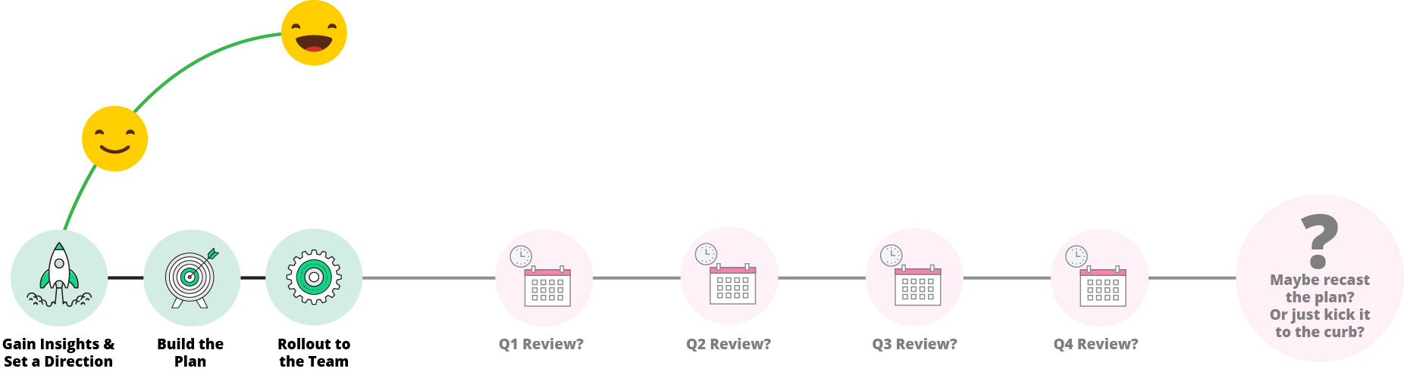
…and you’re leaving success on the table.
Your work is currently here
And you could be finding wins over here.
Notes:
Key Message: Grounding slide on the four core practices. Some organizations are ahead in some areas, behind in others. Sometimes our work covers all four, sometimes the focus is on one.
Transition: “Let’s briefly go a bit deeper into each of these.”

Slide 8
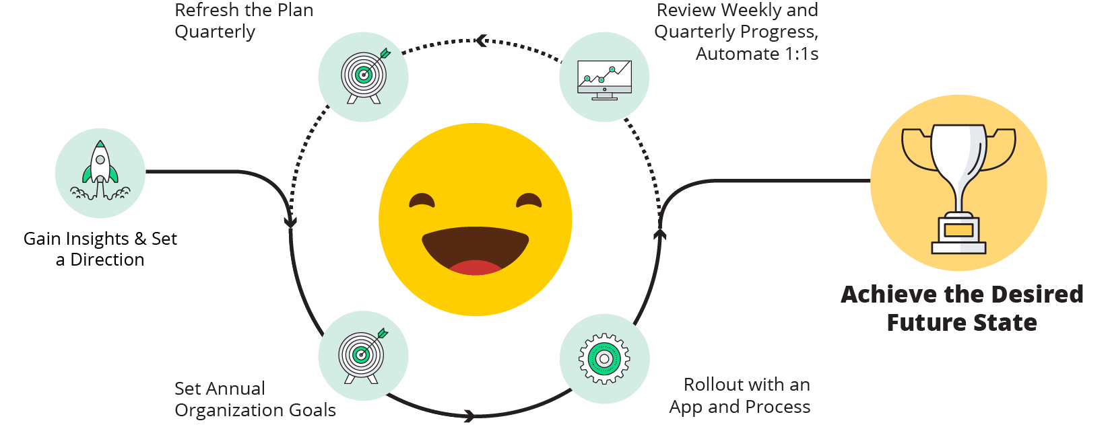
The agile methodology is just more successful.
Notes:
Key Message: Grounding slide on the four core practices. Some organizations are ahead in some areas, behind in others. Sometimes our work covers all four, sometimes the focus is on one.
Transition: “Let’s briefly go a bit deeper into each of these.”

Slide 9
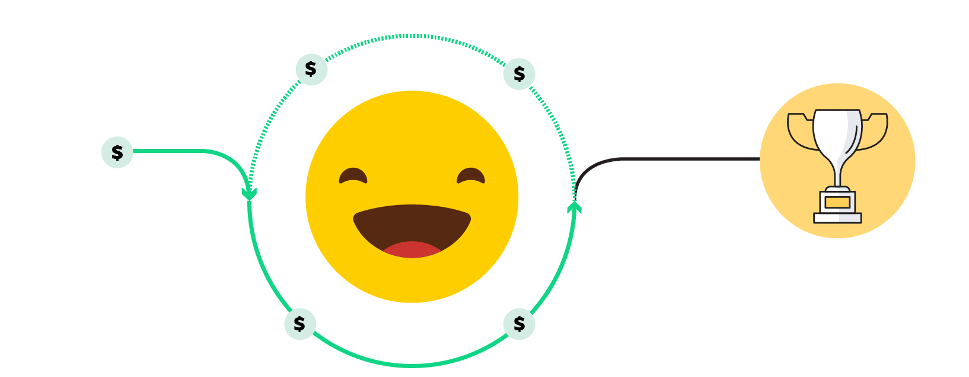
It’s a win-win for everyone.
to create engaged
clients…
Our app and process gives you the ability to earn managed service contracts...
so they can achieve their vision of success.
Notes:
Key Message: Grounding slide on the four core practices. Some organizations are ahead in some areas, behind in others. Sometimes our work covers all four, sometimes the focus is on one.
Transition: “Let’s briefly go a bit deeper into each of these.”

