Slide 2
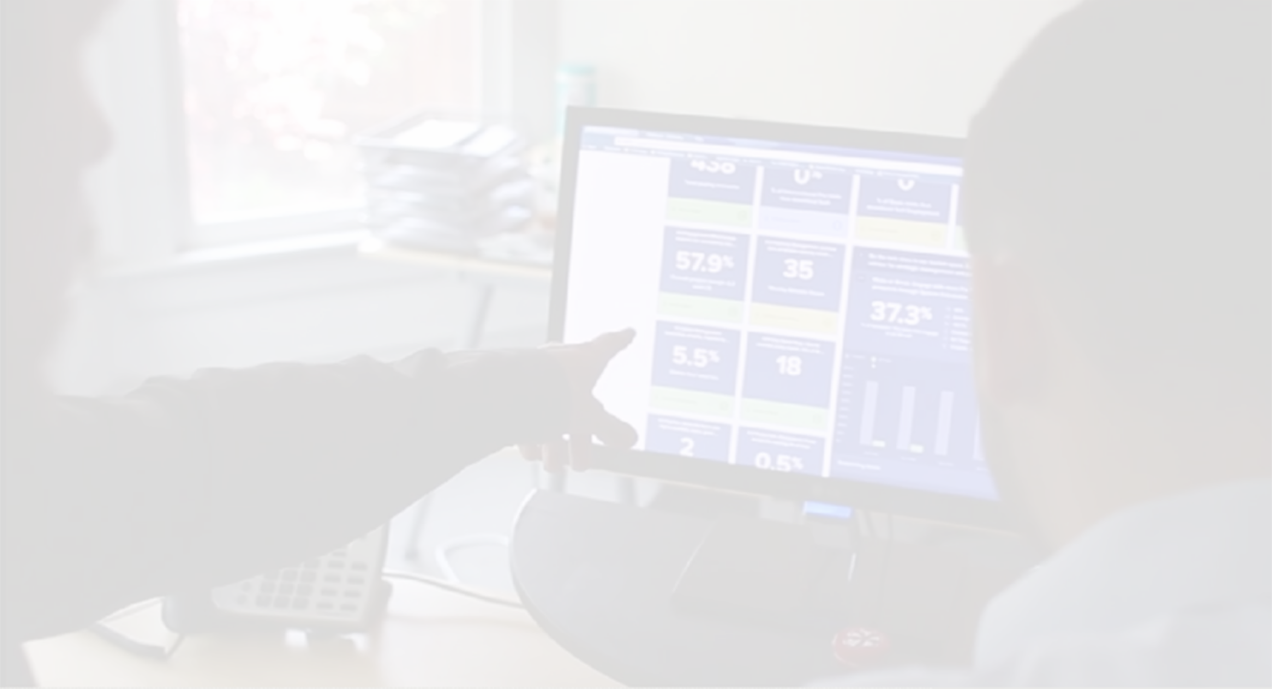
Learn About Our Application
Eliminate the headache of managing strategy in spreadsheets.
Notes:
Change the Headline

Slide 3
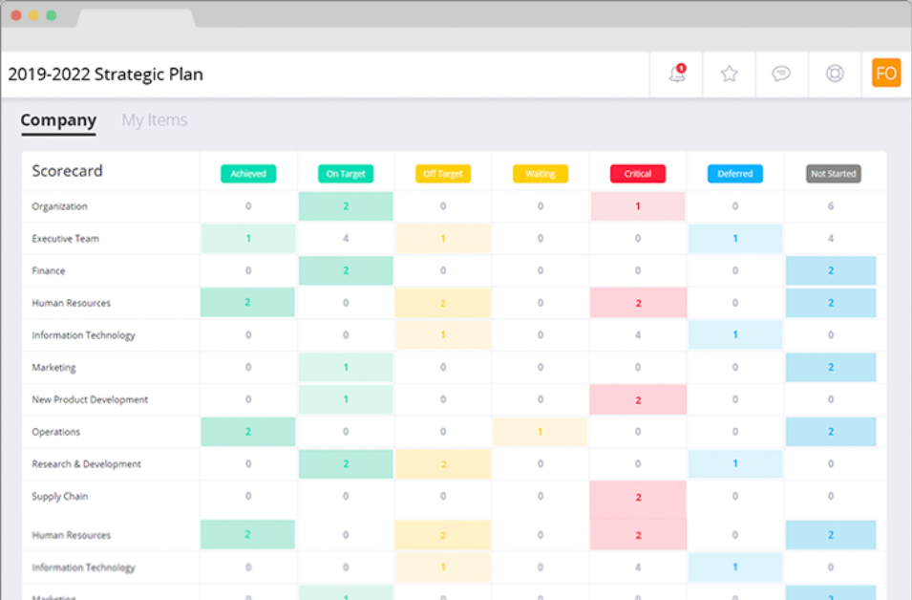
The OnStrategy
Application
The OnStrategy Application leverages the strategy you developed for your clients and creates a manageable system for rollout, organizational adoption, and continuous results management
Simplified goal cascading so you can create shared accountability and multiple plans aligned to your corporate strategy.
Enable your entire team to be part of strategy execution with customized, individualized plan views and quick updating features.
KPI scorecard to show how individual contributions support execution.
Real-time collaboration to build your strategy and manage execution with your team.

Slide 4
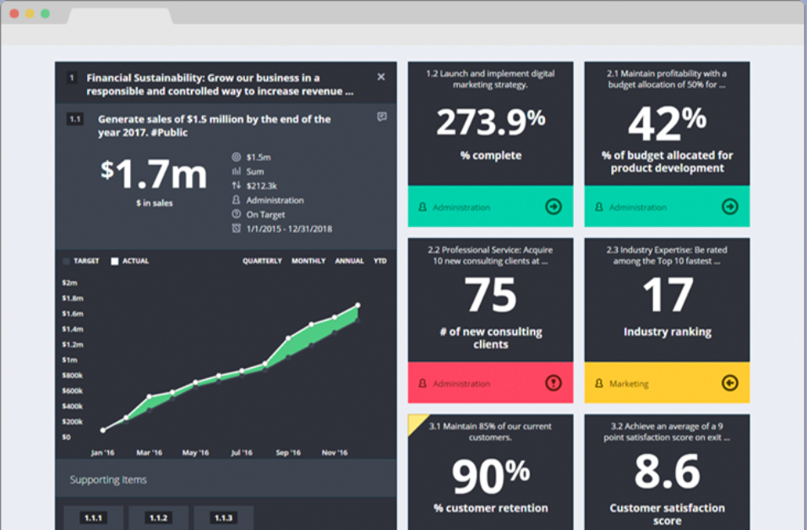
Visual Performance
Dashboard
The Visual Performance Dashboard is unlike other dashboards. It’s more than static metrics. It’s real-time monitoring of core performance indicators connected to the supporting actions across the organization impacting results.
Make your data meaningful with visual displays to provide insight into the core performance indicators driving your success.
View performance with monthly, quarterly, or annual views so you can make data-driven decisions.
Build a culture of transparency by easily sharing performance with an external facing dashboard, PDF report, or an embedded link.
Filter and sort by organizational function, status and priority.

Slide 5
MetricMondays
Weekly/Monthly meetings supported by OnStrategy keeps focus on vital Key Performance Indicators and supporting actions
Performance Dashboard: Easily view current performance and historical trends of performance measures and health metrics.
Alignment: See what’s being done and by who to move the needle on performance indicators.
Filtered Views: Filter performance reporting by priority, team, or individual to drill into areas needing attention.
Agile: Quickly recalibrate existing actions or create new actions.

Slide 6
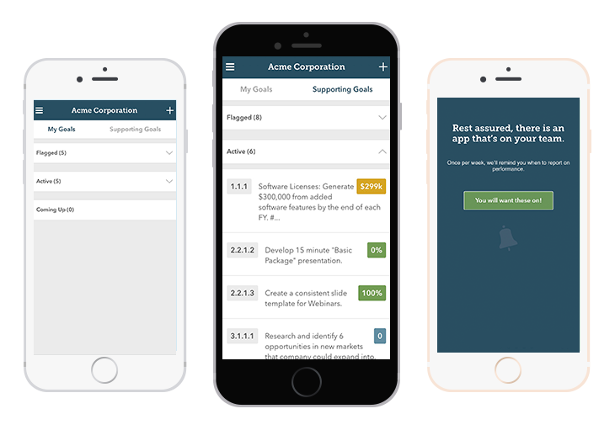
OnStrategy Mobile
OnStrategy’s mobile application makes it easy for your team to quickly manage their performance. It’s easier than ever before to have everyone connected to the strategic direction and their individual actions supporting it.
Stay focused on what matters most by seeing top priorities with a single glance.
Mange performance in 30 seconds with simple, streamlined progress reporting.
Stay Agile - add, edit, and modify goals as needed.
Know exactly where you are and how you’re executing against your strategy by quickly viewing performance.

Slide 7
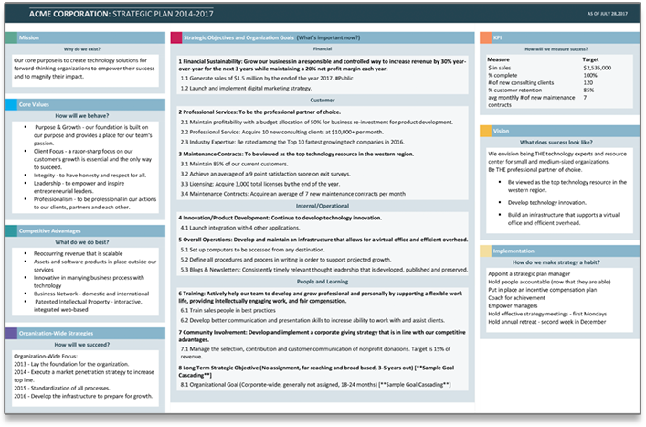
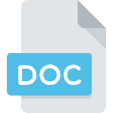
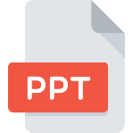
Meeting-Ready
Reports
Clearly and effectively communicate your strategic direction and expectations with corporate and department plan reports. These meeting-ready reports include:
Corporate Plan Reports
Full Strategic Plan
Executive Summary
One-Page Plan
Road Map
Linear Cascade
SWOT
One-Click
Budget
Performance Reports
Full Strategic Plan w/Progress
Executive Summary w/Progress
Scorecard
Strategy Review PPT
Dept. Action Plans
Individual Action Plans
Individual Scorecards
Individual Performance Review

Slide 8
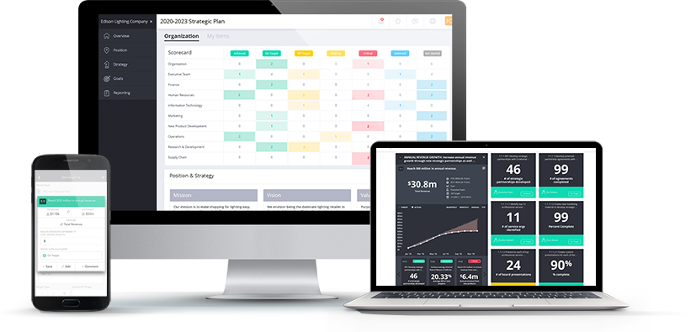
How Our Software is Different
Our software connects long-term business strategy, goals/OKRs, and weekly results to help your organization adapt and thrive.
End-to-End OKR Alignment. Strategic Direction and Priorities identified at the top with Individual and Team performance aligned to the long-term priorities.
Quantitative reporting of results for Corporate and Team Performance.
Communicates performance against goal as quantitative outcomes and results with incremental targets at the Corporate, Team and Individual levels.
Board and stakeholder reporting. Dashboards, custom reports, and external stakeholder accountability.
Plan for short-term accountability to drive the long-term priorities of the organization.

Slide 9
Appendix

Slide 10
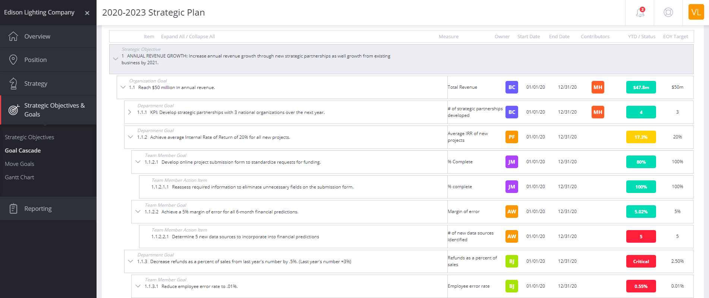
Goal Cascade

Slide 11
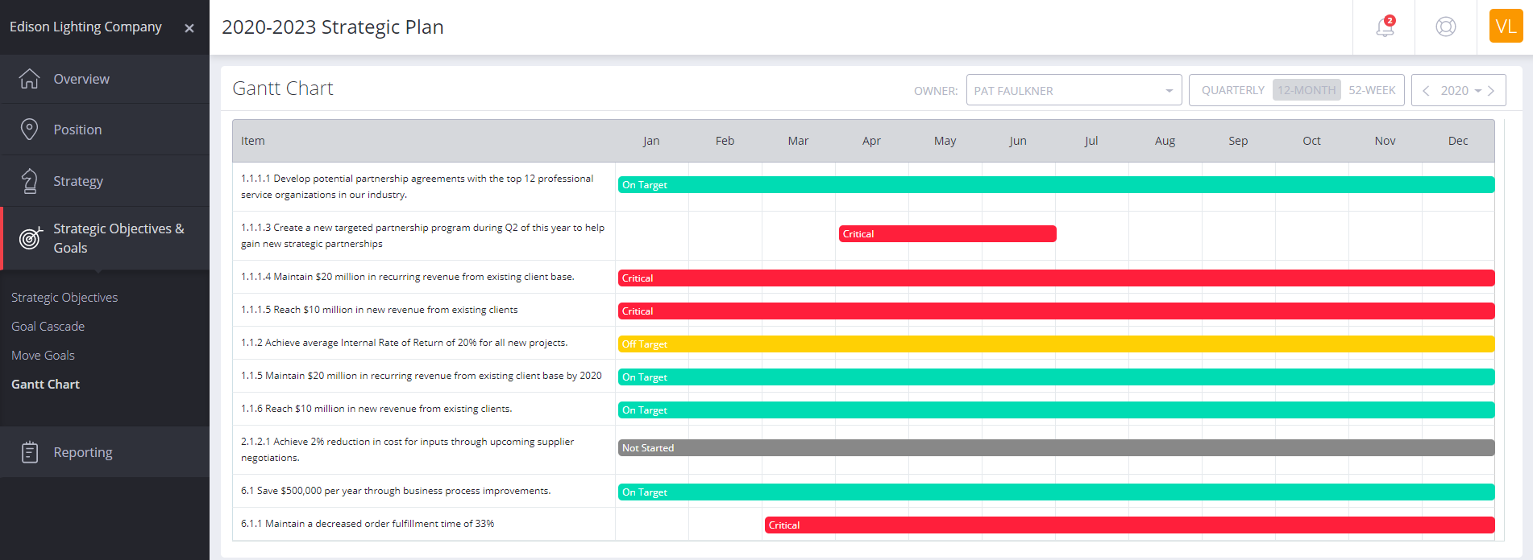
Gantt Chart

Slide 12
Reports

Slide 13
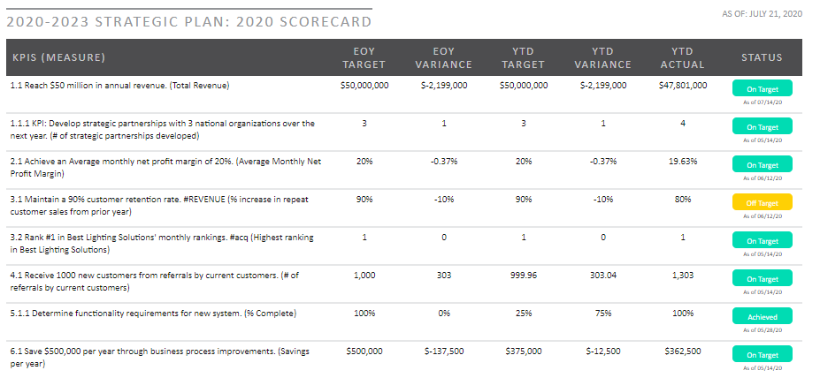
KPI Scorecard

Slide 14
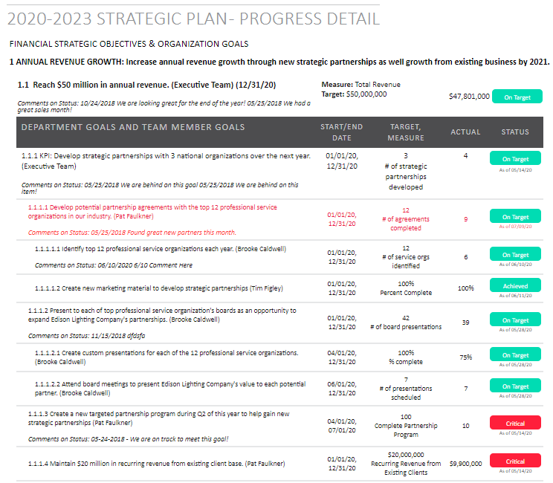
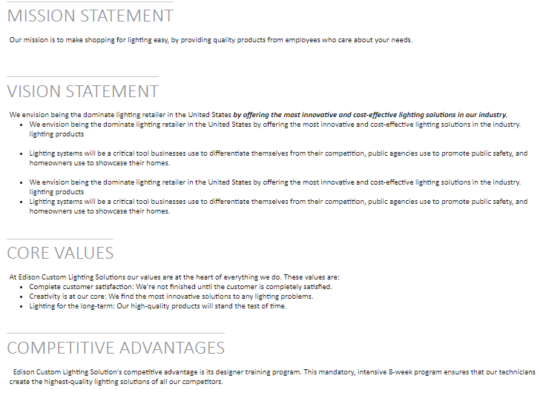
Full Report w/Progress

Slide 15
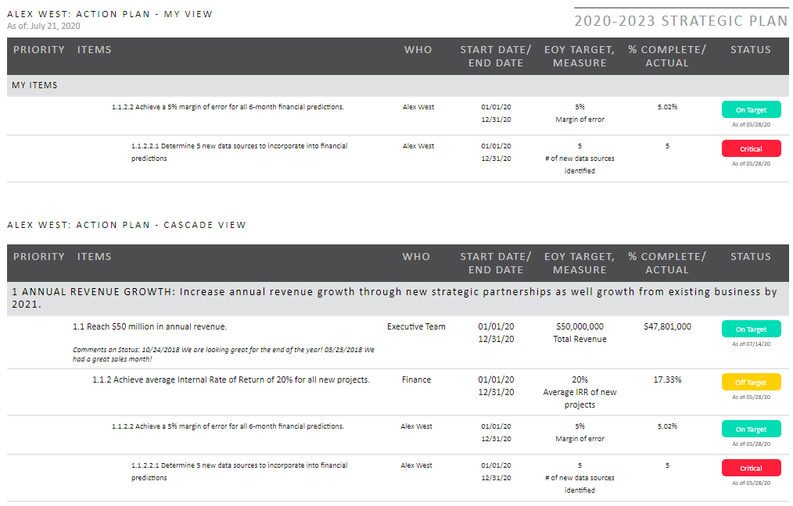
Team Member Action Plan

Slide 16
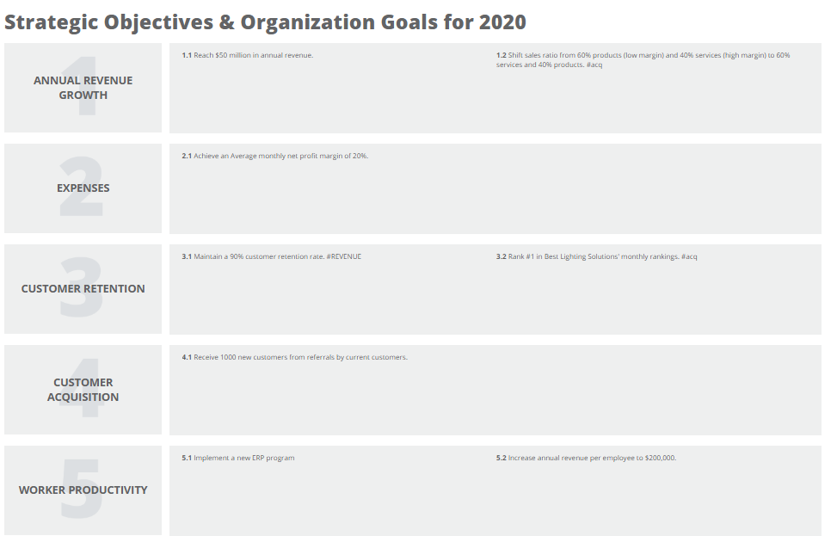
One-Page Communication & Rollout

