Slide 1
Implementation Ready Plan Building and Process 2/24/2021

Slide 2
Building Plans Ready for the Strategic Performance Cycle
Covering all the based during the plan.

Slide 3
Overview
Client Outcomes
Purpose of this Evaluation
Co-build a plan that is ready to support the client’s expectations supporting frequency of performance updates and agile plan adaptation
Align leadership on agreed upon staff expectations
Gain executive sponsorship
Identify internal client advocate who will own the process and become an expert in using the tool.
Enable plan building to drive execution of the Strategic Performance Cycle.
Ensure roll-out, adoption, and continuous management and adaption becomes an operational process.
Identify opportunities to deliver incremental, value-added services
Notes:
We’re not judging quality of the strategy with this eval., simply implementation-readiness

Slide 4
Plan Building Basics
Strategic Foundation & Direction
Mission
Core Values
Vision
Strategic Objectives/Priorities
Plan
Plan Architecture
Measures & EOY Targets
Goal Owners
Performance Process Expectations
Frequency of Plan Refreshes
Better to Also Have:
SWOT
Customer Segments
Competitive Advantages
Strategic Issues
Org-Wide Strategies
Optional:
Action Items
Incremental Targets
Notes:
It’d be super if these bullets were a checklist: we see you have these elements…

Slide 5
Plan Structure & Attributes: Option #1
Align planning team on the plan’s architecture during plan build – consistency is key
Level |  | Planning Element | Accountability (Owner) | Timeframe (Start/End Dates) | Measure & Target Types (Measure & Target)
1 | Where? | Strategic Objectives/Priorities | N/A | 3+ Years
1.1 | What? | Organization-wide Goals & KPIs | Executive Leadership | 1+ Year or longer | Measure: Quantifiable (KPI) Target: Incremental & End-of-Year
1.1.1 | How? | Key Results/or Initiatives Quant Outcomes OR Effort/Project | Functional Leads / Managers | ~1 Year | Measure: % Complete or Quantifiable Target: Incremental & End-of-Year
 |  | Action Items | Individuals | Quarterly | Measure: % Complete Target: 100%
1.1.1.1 |  | Milestones or Action Items | Individuals | Quarterly | Measure: % Complete Target: 100%
Notes:
Red = to be completed either from what we gather or in the kickoff/first plan eval meeting

Slide 6
Plan Structure & Attributes: Option #2
Align planning team on the plan’s architecture during plan build – consistency is key
Level |  | Planning Element & Definition | Accountability | Timeframe | Measure & Target Types (Measure & Target)
1 | What (overall) | Strategic Objectives/Priorities | N/A | 3+ Years
1.1 | What (this year) | Company-wide Goals | Executive Leadership | 1+ Years | Measure: Quantifiable (KPI) Target: Incremental & End-of-Year
1.1.1 | What (this year) | Team/Department Goals | Functional Leads | 1+ Years | Measure: % Complete or Quantifiable Target: Incremental & End-of-Year
1.1.1.1 | How | KPIs and/or Initiatives Quant Outcomes OR Initiatives | Functional Leads / Managers | < 1 Year | Measure: % Complete or Quantifiable Target: Incremental & End-of-Year
1.1.1.1.1 |  | Action Items | Individuals | Quarterly | Measure: % Complete Target: 100%

Slide 7
Checklist to Complete Your Plan
Are Your Goals (X.X) Impactful?
Are your Goals, Initiatives & Actions Implementation-Ready?
Stated as clear outcomes of what you want to achieve.
Clear measure of success (KPI) that is quantifiable with an identified data source.
Each goal has 2 to 3 supporting initiatives —how the goal will be achieved.
Owners (and potentially contributors) assigned.
Start and end dates (following the plan structure).
A clear measure of performance (% complete or quantitative).
An end-of-year target.
Incremental targets (monthly — at least quarterly).
Notes:
Think it’s kind of important to continue reinforcing the levels (X.X)

Slide 8
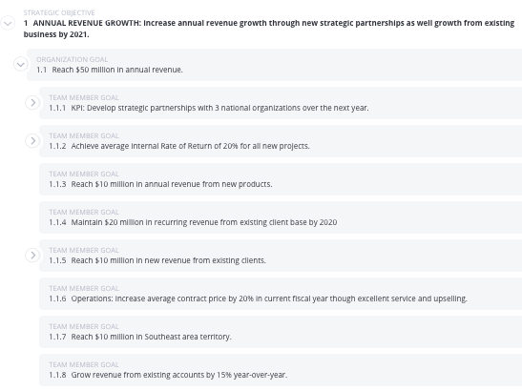
Supporting Initiatives
Why?
Provide leading performance information about goal progress & detail HOW the goal will be achieved.
Initiatives are the HOW that support the WHAT (Goals).
Established quarterly, annually or semi-annually.
Help to focus strategy review conversations on how we’re progressing, where we’re stuck, what we need to get unstuck.

Slide 9
Great Initiatives (Or Key Results)
Key Results/Initiatives are the “Hows” an Objective/Goal will be achieved.
KRs/Initiatives are the inputs to achieve the output.
A good KR/Initiative describes a deliverable OR a result, not activities.
If your KRs include words like "maintain," "strive," "continue to," or "participate" these are activities.
Start each KR/Initiative with an action verb and continue the sentence with a description of what will be delivered with evidence of completion (evidence must be verifiable and accessible to relevant parties).
"With Key Results, this isn't meant to encompass everything that's happening but only those things that make a truly meaningful difference." - John Doerr, author of Measure What Matters
Notes:
“KR’S Come in two flavors” - measures or effort. KRs don’t have to be metrics, they can be an "outcome/quantifiable metric" OR "effort initiatives” with project-based measures or outcomes.

Slide 10
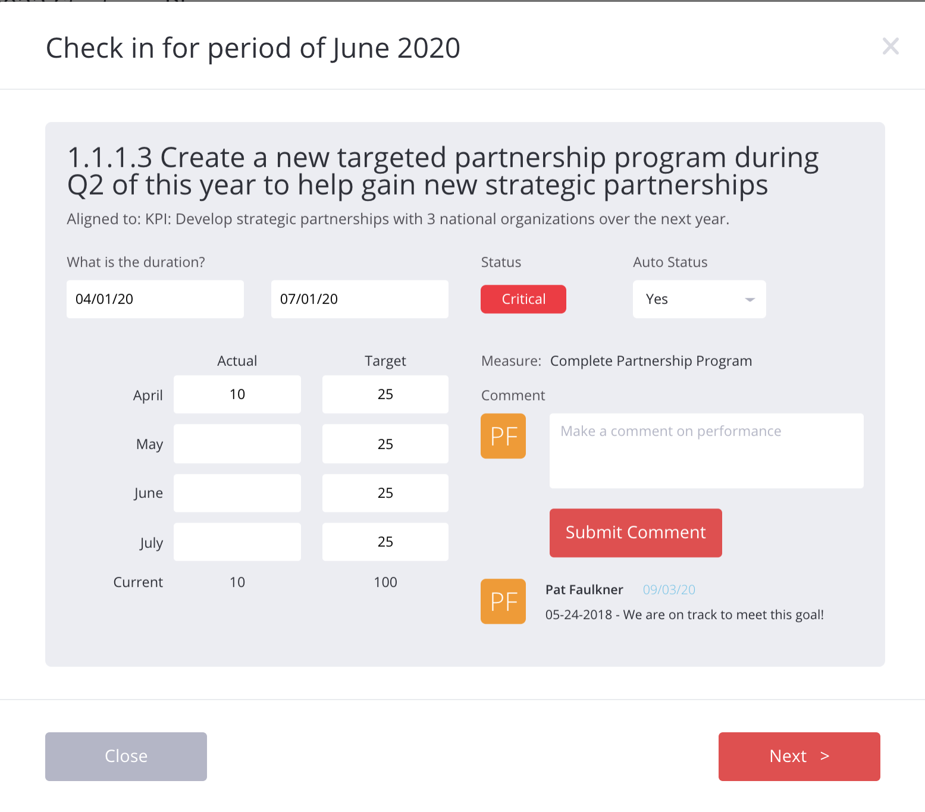
Assign Owners
Why?
The owner is responsible for reporting results/progress and a comment to explain the status of a goal on a monthly/quarterly basis. This includes:
Updating the goal’s status.
Update the goal’s results.
Leaving a comment about performance
Heyden, can we please replace this visual with visual B on P1 of the results reporting cheat sheet? ☺ Is it possible to also include steps 3 & 4?

Slide 11
Start- & End-Dates
Why?
Provide timeframes for who is doing what by when & guardrails for how long we have to achieve the “what” or complete the ”how.”
Start- & end-dates of children should fall within those of the parent.
Start- & end-dates should generally follow the guidelines of the plan structure (e.g., initiatives are quarterly).

Slide 12
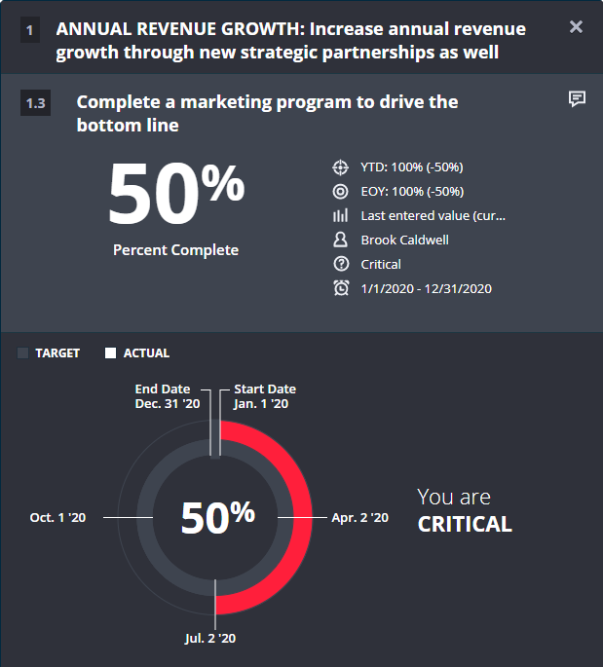
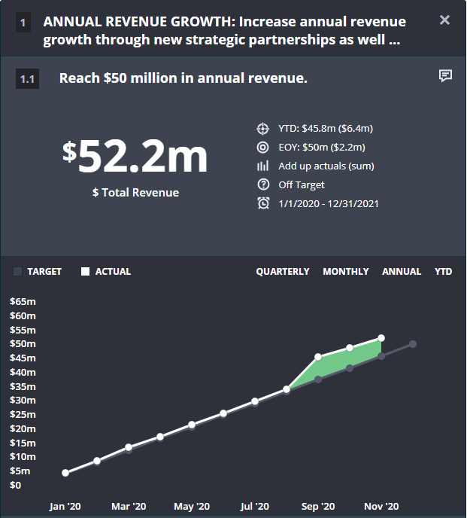
Measures
Why?
To allow owners to clearly measure progress.
Generally 2 types of measures:
Percent Complete: Used for effort-based or project type goals. We will know, by our best managerial estimate, when a goal is 25%, 50%, or 100% complete.
Quantitative: Verifiable results based on a data source ($, #, %).

Slide 13
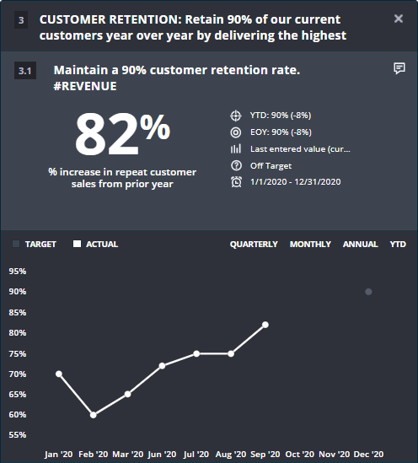
End-of-Year Targets
Why?
Sets a target or outcome for the year or term of the goal.
End-of-year targets are critical to assess what the organization is attempting to accomplish. Identifies where you want to be by when.
1

Slide 14
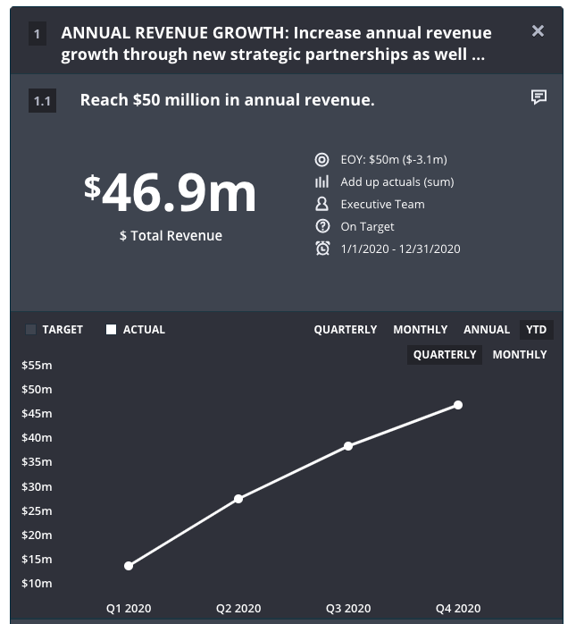
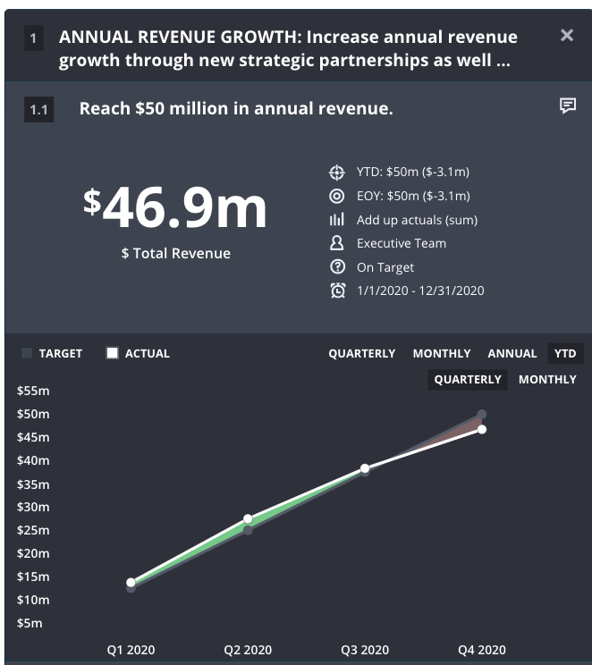
Incremental Targets
Why?
No Incremental Targets
What Good Looks Like
Compare current actual to where progress / performance should be at a point-in-time (not just the end-of-year or completion date of goal).

Slide 15
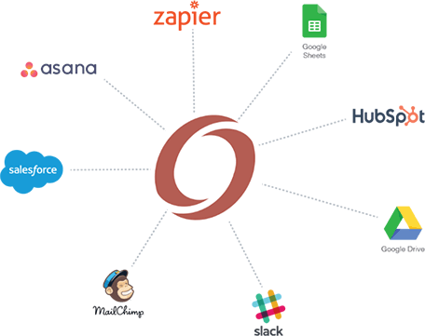
Data Sources
For quantifiable measures:
Identify the data source.
Define the frequency of reporting.
Determine if it makes sense to automate the data feed using API.
Notes:
Here is where we provide recommendations for filling the implementation-readiness gaps, e.g., set targets and dates in-app, add Q1 initiatives in app, etc.

Slide 16
Establishing Client’s Process Expectations Supporting the Strategic Performance Cycle
Gaining consensus and alignment during the plan build process.

Slide 17
Monthly Reporting Cycle
Company Review
Team Review
Individual Reporting
Set Annual Company
Goals
Quarterly Refresh Meeting
Present Performance and Share upcoming Quarterly Team Key Results, Publish Results
Monthly Metric
Review
Meeting
Set Team Annual Goals
Monthly Metric
Review
Meeting
Set upcoming Quarterly
Priorities
Report Quarterly Results
Set Quarterly Priorities
Report Progress
1st Fri.
2nd Wed.
2nd Fri.
Before Month 1
Typical Month
Month 4
Whole Organization | Team | Individual
17

Slide 18
Quarterly Cadence
All-Hands
Q3 Performance
Review
All-Hands
Q2 Performance
Review
All-Hands
End-of-Year
Review
Monthly Review
Monthly Review
Monthly Review
Monthly Review
Monthly Review
Monthly Review
Mid-Year
360s
End-of-Year
360s
Monthly
Staff
Monthly
Staff
Monthly
Staff
Monthly
Staff
Monthly
Staff
Dec
Jan
Feb
March
April
May
June
July
Individual | Team | Organizational

Slide 19
Schedule For Monthly Reporting
WEEKLY SCHEDULE |  | Approach | Who
Every Monday | CHECKIN: Report on progress to date | OnStrategy Alert | Everyone
Every Wednesday | TEAM MEETING: Share out of progress & review of KPIs | Team Meetings | Teams
1ST Friday | LEADERSHIP TEAM MEETING: Share out of Progress (MONTHLY) | LT MEETING | LT
QUARTERLY SCHEDULE |  | Approach | Who
By end of previous quarter | Publish companywide and team goals for upcoming quarter | CEO Communication | CEO
By 1st Friday, Month 1 | MONTH 1 RESULTS REVIEW & SHARE OUT | LT Meetings | Managers
By 1st Friday, Month 2 | MONTH 2 RESULTS REVIEW & SHARE OUT | LT Meetings | Managers
By 1st Friday, Month 3 | MONTH 3 RESULTS REVIEW & SHARE OUT | LT Meetings | Managers
By 1st Friday, Month 4 | MONTH 4 FULL TEAM REVIEW - Team shareout and focus for next 90 days | All Team Meeting | Everyone
By 2nd Friday, Month 4 | Review next quarter goals w/ managers + enter in OnStrategy | 1:1s | Managers + Direct Reports
19
Notes:
Cross-Department Goal Teams w/ Goal Leads
In this model, goals are assigned to cross-department teams. Primary corporate goals are assigned to a manager and the supporting initiatives are assigned to individuals or a division. Teams gather once a month to discuss initiative’s progress, actions in-progress or completed, and review performance measures. Additionally, Goal Teams must also come to the monthly corporate strategy review meeting to report on the progress of their goals and actions.
Department/Functional Teams w/ VPs or Department Managers as Leads
In this model, initiatives are still assigned with a cross-functional mindset, but Department Managers, Assistant Managers, and Supervisors meet monthly to talk about the initiatives that fall within their division and the corporate goals they support. Then, Department Managers come to the corporate monthly strategy review meeting ready to report goal-by-goal on the initiatives they own.
Individual Management w/ Individual Contributors as Leads
We expect that individuals will do what was assigned to them in the plan, then come to the monthly corporate strategy review prepared to speak to their progress so we can see our collective progress against the goals. This is one of the simpler approaches and can speak to the direct structure of your plan.

Slide 20
Monthly Results Review
Attendees: All Team Leads
Purpose: 20% Team Performance 80% Set Company Focus & Identify Strategic Shifts/Trends
Agenda
Welcome and Opening Remarks (CEO)
Highlights and lowlights from the previous week
Priority Report Out By Team Leader(<15 mins each)
Notable accomplishments of prior week priorities (greens/achieved)
Carrying forward existing priorities?
Sharing out new, upcoming weekly priority (challenges, obstacles, dependencies.)
Or, carrying forward existing priorities: Why? What will change to address the priority?
Recap on Priority Adjustment & Follow Ups (CEO)
Using OnStrategy: Dashboard w Filters by Team for Objectives, Key Results, Weekly Priorities

Slide 21
Quarterly Refresh
Attendees: All Team Leads together
Purpose: 20% Review Company-wide Performance 80% Set Company Focus & Identify Strategic Shifts/Trends
Agenda
Welcome and Opening Remarks (CEO)
Highlights and lowlights from the previous quarter
Financial Overview/key numbers
Strategic Pillar Performance (15 mins each)
Overall pillar performance
OKR Report Out – by Manager
Notable accomplishments (greens)
Addressing reds and yellows – what do we need to do to “go green”?
Focus for the next quarter
Recap on OKR Changes & Follow Ups (Strategy Leader or CEO)

Slide 22
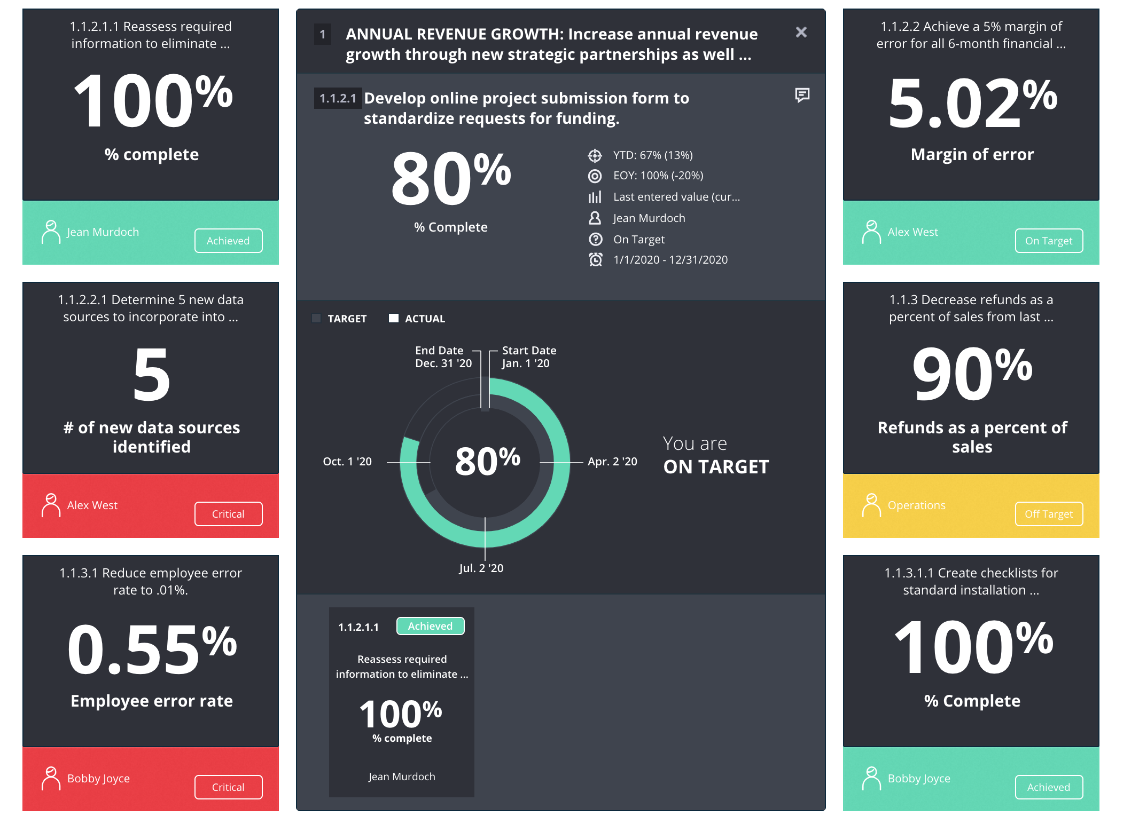
Results Review Talking Points
2. KPI OR Deliverable Report Out (2 mins or less):
Overall performance of the KPI/deliverable - % complete, on or off target?
Accomplishments/Stalls: What did we accomplish days? Where are we stuck or did we stall?
30-Day Focus: What is the focus for the next 30 days?
Asks: Are there specific “asks” of the group?
1. Initiative Report Out (30-seconds or less):
Overall performance of the Initiative – Current Status is on- (green) or off-target (yellow) or critical (red).
Notes:
Keep, but update…

Slide 23
Approach To Planning & Management
Approach to Vision, Priorities & Strategy Formulation
Decision Making? | CEO ----------------------------------------Corp Leadership Team ----------------------------------Regional Leadership Team
Planning Process? | Top Down -------------------------------------------------------------------------------------------------------------------- Bottom Up
How Deep to Cascade? | Corp Leadership -------------------------------------Regional Leadership ---------------------------------------Regional Teams
Type of Plan | New Efforts Only (aka strategic) ----------------------------------------------------------- All Ops Performance & New Efforts
Communicating the Plan
Needs to Inform? | All Staff | Board |  | Shareholders | ? |  | ?
Using the Plan (Governance & Implementation)
Implementation Method | Individuals |  | Department/Function Teams |  |  | Goals Teams
Budget Alignment | Loosely coupled |  | Within existing budgets |  |  | StratX
Governance Method | None |  | Exec Team Accountability |  |  | Team Lead Accountability
Progress Reporting Method | Weekly |  | Monthly |  |  | Quarterly

Slide 24
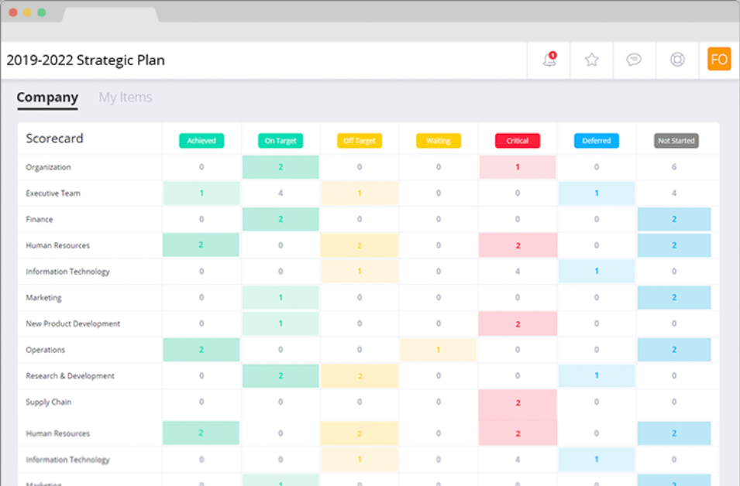
OnStrategy is the Tool
to Support the Process
OnStrategy leverages the strategy you developed for your clients to reinforce your client’s expectations around frequency and participation during performance reviews and adapting the strategy on a continuous basis.
Simplified goal cascading so you can create shared accountability and multiple plans aligned to your corporate strategy.
Enable your entire team to be part of strategy execution with customized, individualized plan views and quick updating features.
KPI scorecard to show how individual contributions support execution.
Real-time collaboration to build your strategy and manage execution with your team.

Slide 25
Project Plan
Date | Activity | Responsible
 | PHASE 1: Align Purpose & Direction
By 2/11 | Draft Interview Questions
By 2/19 | Conduct Executive Interviews (7):
By 2/23 | Draft & Approve Management Survey Questions
By 2/25 By 3/9 | Launch/Close Management Survey: Up to 25 participants w/ 10-12 survey questions
By 3/16 | DELIVERABLE: Executive Insights & Management Survey Report
 | PHASE 2: Establishing Strategic Framework
Ready to start by March 22 | Planning Retreat:
TBD | Deliverable: Draft Strategic Plan
TBD | Deliverable: Final Strategic Plan
By May 15th | DELIVERABLE: Strategic Plan in OnStrategy Platform | OnStrategy
 | In-App Initiative & Action Planning
 | PHASE 3: Agile Process & Systems to Manage Performance
June | Revisit the Management Process & Implementation Schedule
June | DELIVERABLE: Management Process Playbook
 | Team Training
 | Monthly Review
 | Monthly Review
 | Quarterly Review
Notes:
Here is where we provide recommendations for filling the implementation-readiness gaps, e.g., set targets and dates in-app, add Q1 initiatives in app, etc.

