Slide 1
Creating and Sustaining Organizational Focus
Notes:
“Welcome to the training for OnStrategy. The purpose of today’s meeting is to train our team on the platform that we’ll be using to help us develop and monitor our strategic plan. This tool should allow us to update and review performance in real time, so that we can manage against our plan while also adapting it to ensure that it stays relevant throughout the course of the year.”
Set Expectations – What is going to change moving forward as a result of using this tool?
What kind of goals is your team building/inputting into the system?
How often will they be expected to update the plan? (Weekly/Monthly)
How will the team use the tool to manage against the plan? (Monthly/Quarterly Strategy Review Meetings)
“Let’s jump in to take a look at the platform.”

Slide 2
Benefits of using Onstrategy
Through strategic planning, you can drive engagement, alignment and ownership:
Engagement: Getting the right people involved
Alignment: Building consensus with focus and clarity
Ownership: Knowing what needs to be done and by who
Benefits of on OnStrategy, specifically
One version of your plan: A single source of truth
Consistent reporting, dynamically generated- Check progress with a single click
Org-wide engagement- Built in communication and collaboration tools
Quickly update progress- Intuitive interface for capturing progress updates
Dynamic Planning- Keep strategic planning relevant by having a living, breathing plan that guides decision making
Notes:
“Implementing this tool to manage the process should save us time and help us be more clearly aligned about our priorities and transparent about our performance against the supporting goals. It is intended to make our lives easier, while also ensuring that we’re working collectively as a team to drive results as an organization.”

Slide 3
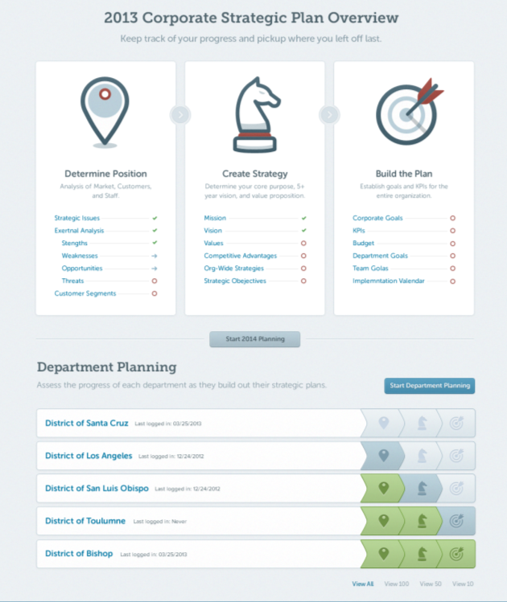
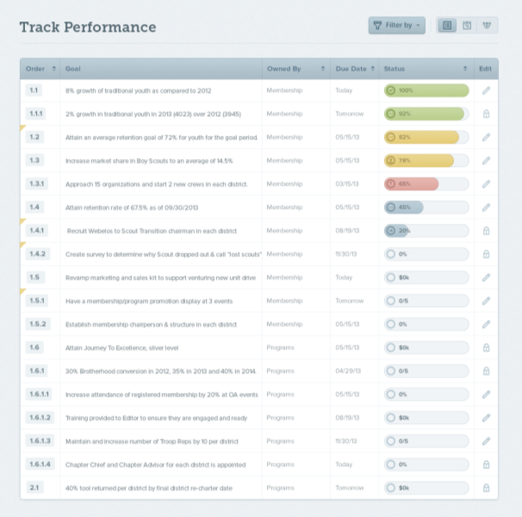
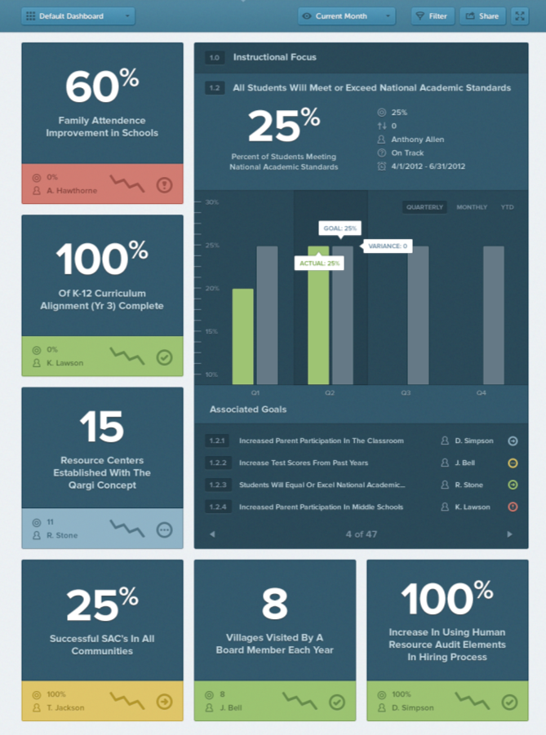
What is OnStrategy?
OnStrategy is web-based software that empowers people to create and execute great strategy.
Notes:
“OnStrategy is entirely web-based, so you can bookmark the link, OnStrategyhq.com, for easy future access. After this training, I’ll send you a link to the platform along with your unique username and password.
To help orient you to the platform, it’s important that you understand the 4 primary sections within it.
First is the Home Page, this will pull our plan together in one place so that we can always see how we’re doing with a quick glance.
Second is the Plan Section, which is meant fi developing and/or inputting our plan. This is where you’ll go to build out the goals that we’ll discuss in a minute.
Next is the Performance Section, which is where you’ll go throughout the year to update your performance against the goals that you’re accountable for. The mobile application is a skimmed-down version of the Performance Section.
Finally, we have a Reports Section, which will output all of the downloadable and dynamic reports in the OnStrategy system. This is what is going to save us a lot of time, in that we can download both plan reports and reports with progress, rather than needing to recreate them every time.
You can navigate between these sections using the blue section headers at the top of the OnStrategy platform. You’ll see them in the upper, right-hand corner when you log in.”

Slide 4
Creating focus – Plan Section
Notes:
“We’re going to look at the Plan Section first. Again, this is where you will go to build your individual goals in alignment to the Organization goals. You will also be able to navigate this section to see the full Organization Strategic Plan.”

Slide 5
Step-by-step plan creation
Step-by-step guide to develop your plan in three phases.
Keep track of what you completed, what is in progress and what is not started.
Monitor progress of department or individual plan development.
Notes:
“When you navigate into the Plan Section, you’ll see a 3-phase, step-by-step guide that outlines all of our different planning components. I, as the Strategy Leader, am responsible for updating and inputting all of the Organization-Wide information, but you’ll be able to view it and add to it at the Department and Team Member levels, respectively.
To create the 3-5 goals that you’ll be responsible for as part of the strategic plan, simply click on the Strategic Objectives hyperlink (which is the last item in the middle column).

Slide 6
Goal Cascading
Number | Level | Who is responsible | Time Frame
1 | Long-Term Strategic Objective | Not assigned – far reaching and very broad | 3-5 years
1.1 | Corporate Goal | Corporate-wide – not assigned Must have Target and Measure (KPI) | 18-24 months
1.1.1 | Department Goal | Assigned to Department responsible for seeing this goal completed. Must have Target & Measure | 12-18 months
1.1.1.1 | Team Member Goal | Assigned to Team Member responsible for seeing this goal completed. Must have Target & Measure | 6-12 months
1.1.1.1.1 | Team Member Action | Assigned to Team Member responsible for seeing this action completed. Short term items only. Must have Target & Measure | 30, 60, 90 days
Notes:
“The result of building cascading goals is that it results in a plan that aligns all of our individual efforts and maps them back to what we’re trying to achieve as an organization. You can think about the goal cascading, or leveling, like this table that we’re seeing. The system will automatically number things for you, so it should make the process very easy. It’s also important that you conceptually understand the purpose of goal cascading and how to appropriately build it out.”
*Offer to have someone help your team on an individual basis if they’re unsure what their goals should be, or how they fit into the overall strategic plan.

Slide 7
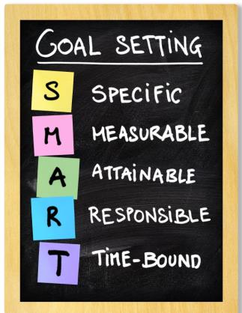
Tips: Think S.M.A.R.T. when you create your Goals
Provide direction, clarity and momentum to achieving a vision
Communicate the outcome (Why)
Be clear about ownership/accountability
Clear and simple
To (action verb) (single key result) by (target date) requiring (resources).
Goals are dreams with deadlines.
-Diana Scharf Hunt
Notes:
“The various fields, or template, in the system help ensure that you’re creating SMART goals. We want to make sure that our goals are starting with a verb, and are Specific, Measurable, Attainable, Responsible and Time Bound. I want to walk you through the various fields used in the OnStrategy platform to make sure that you’re comfortable using them”

Slide 8
The Anatomy of a Good Goal
(Action verb) + (single key result – from X to Y) + (purpose – why) through (explain how if the clarity is necessary) by when (target date).
Notes:
“When you understand the full concept of developing a SMART goal, you can start to put the pieces together to develop a cohesive idea in a statement, as is shown here. Keep in mind, it’s always really useful to start the statement with a verb to incite action and communicate directionally what the goal is about.
Let’s take a look at how we develop and input cascading SMART goal in the OnStrategy system with a video. You can access this same video again, as well as other resources by clicking on the button with a “?” icon in the upper, right-hand corner of this page. You’ll notice this same button on virtually every page in the platform, so be sure to use it as a resource!”

Slide 9
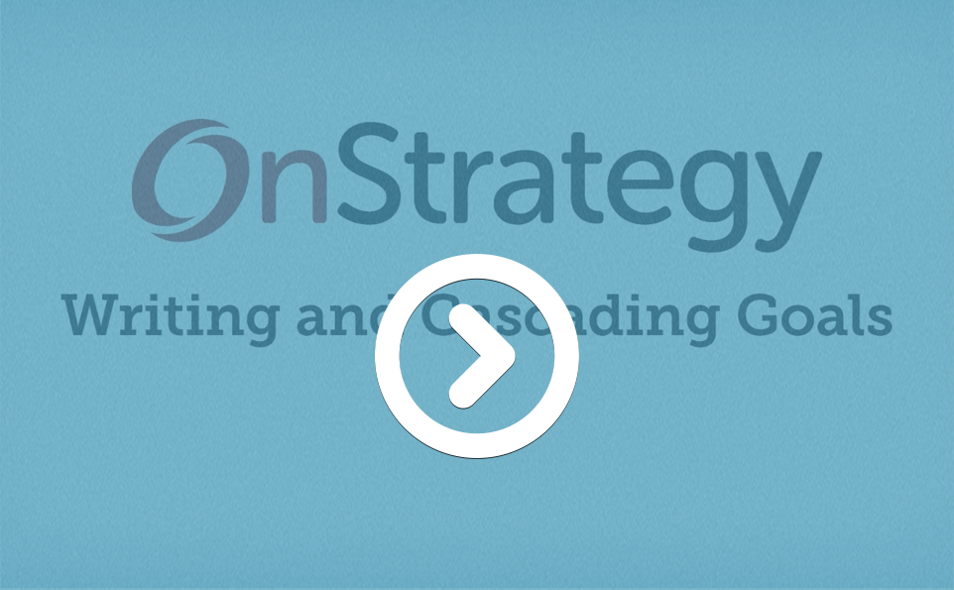
Creating Goals
Notes:
Play video here.

Slide 10
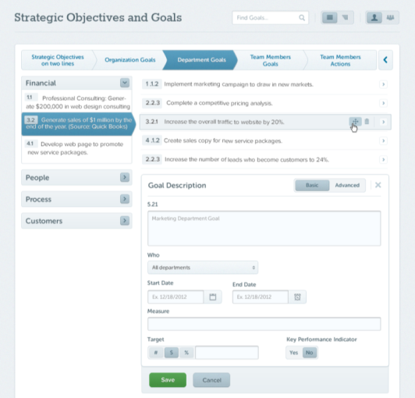
Strategic Planning Best Practices
Cascading Goals: Up to 5 levels of goals ensure you can build out who is going to do what by when.
SMART Goal Development keeps your goals actionable.
3
Notes:
“Now that you understand how to create a goal in the system, I want to be sure that your comfortable navigating through this page.
Along the left, we have the framework of our plan built out into different Perspectives and Strategic Objectives, which are supported by Organization Goals. The framework along the left helps orient you to the portion of the plan that you’re drilling into while a small, right-facing arrow on each goal allows you to drill deeper. To jump up a level, click on the left-facing arrow to the right of the Team Member Action Item Level.
You want to be sure that you’re always working in support of the appropriate goal, and at the appropriate level within the cascade.”
*Be sure to make your team aware of which levels you’re asking them to add their goals to. Provide clear instructions regarding where they should be adding goals in alignment to the organization plan, and any other guidelines with regards to goal development (how many, types of goals, etc.)

Slide 11
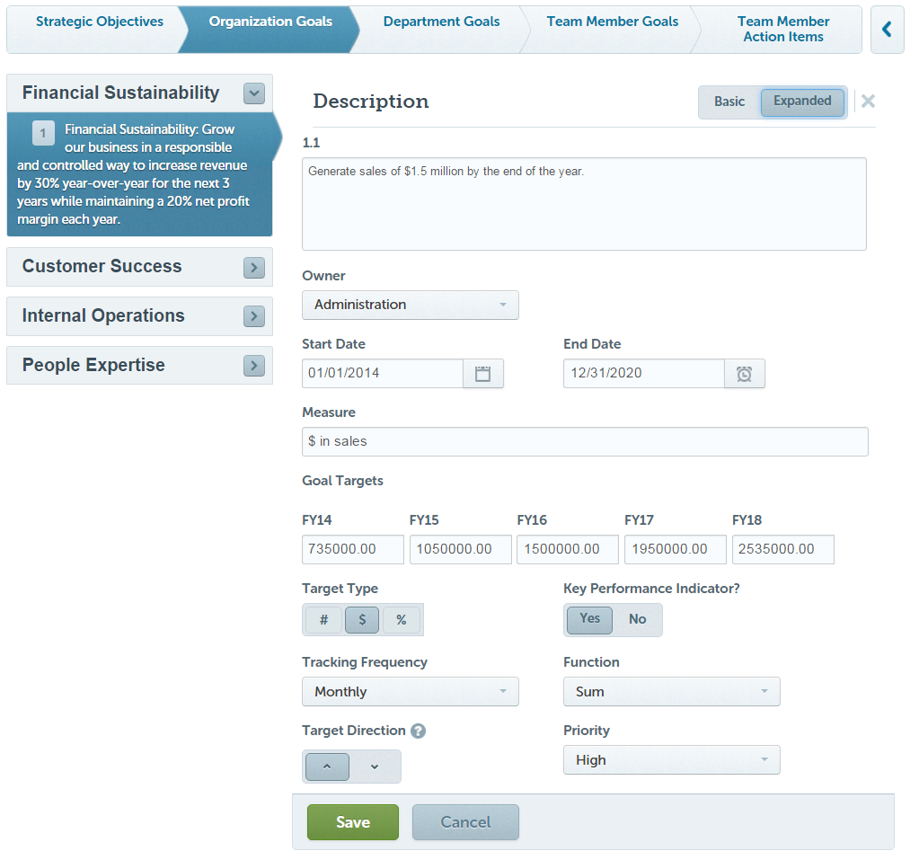
Creating a Goal
Goals are dreams with deadlines.
-Diana Scharf Hunt
Notes:
Here is a list of the different fields used to create a goal, and what they mean:
Owner – who is responsible for the goal. Only departments and names that I’ve entered in as users will appear, so let me know if you think someone is missing.
Start Date –The day the goal begins.
End Date – The date the goal ends. This can be several years in the future if you’re setting a multi-year goal. You’ll notice different target fields appear for each fiscal year that your start and end date range spans.
Measure – This should be the description of what your Target value is.
Target – Here, you can set annual targets. I’ll show you later in the Performance Section how you can actually set incremental targets, weekly & monthly, throughout the year.
Target Type- This is they type of number that your target value is, either a number, a currency or a percentage.
KPI – You can elect to tag a goal as a KPI. This will make the goal appear on your KPI scorecard.
Tracking Frequency – This is the frequency with which you need to update the status of a given goal.
Function – This is the function that you want OnStrategy to use to calculate and aggregate the data that you’re updating on a weekly or monthly basis. As an example, for a sales goal, you’d want to select “Sum,” so that they system adds up the updates that you make on a monthly basis. Versus, a different type of goal that you may want to see the average or current value throughout the year.
Target Direction – This indicates whether it’s your intent/desire to be above or below the target value that you set.
Priority – You can set goals as High, Medium, or Low priority. Keep in mind- you don’t have to use this field if you don’t want. Also keep in mind that anything marked as a high priority will show up in red font on the reports.

Slide 12
Goal Cascade Examples
Increase average revenue per key account by 5% by end of year 2016. (Measure: $ in revenue per key account/ Target: $25k)
1.1 Increase use of promotional incentives for new product purchases to achieve a 30% success rate.
1.1.1 Redesign multi-touch marketing campaign for key accounts.
2. Demonstrate our foundational values and company culture by maintaining 80% employee retention. (Measure: % of employees retained/ Target: 80%)
2.1 Promote professional growth and career fulfillment by having 100% of mid-level managers complete professional development program annually.
2.1.1 Research different professional development software systems.
Notes:
“This slide and the next outline a few strong examples of goals, supported by coordinating individual goals and action items. This cascade should give you a more detailed understanding of the purpose of developing a goal cascade that aligns our strategy to the individual actions of our team, as well as provide you with a clearer understanding of how to actually do it.
There are a few key ideas/things to note about these examples:
The high-level organizational goal is what we call and outcome-based metric. It demonstrates the result of having successfully achieved the supporting goals and actions.
Each of the goals is then broken down into an individual goal with a supporting action item. Note that all of these goals will still be SMART as we use the OS platform criteria to assign a due date, owner, measure and end date for each goal.
Not all goals will be easily quantified. Take both of the above action items, 1.1.1 and 2.1.1 above. These are great examples of action items that are process, or project-based. When you set up action items like this in the system, you’ll want to set your measure as “% complete,” and your target as “100%”. Quick note with these goals – you also want to set the function to “current,” so that each time you make an update to a goal, it will display your most recent progress update in the reporting features.”

Slide 13
Sustaining Focus – Performance Section
Notes:
“Now that we have an understanding of how we’re going to use the OnStrategy system to finish building our plan, we need to look into how we will manage our performance against the plan throughout the year.
The Performance section allows us as a team to not only update our individual performance, but to also look at how we’re performing as a team and determine what our focus needs to be to drive results.”

Slide 14
Implementation Overview
How will we use the plan as a management tool?
Definition:
Implementation is the process that turns strategies and plans into actions in order to accomplish strategic objectives and goals.
Outcome: Synching checking in with your plan into the “rhythm of your business”
Notes:
“Before we look at the tool itself, let’s first address what is going to change for us as an organization as a result of having done planning. We’ve worked really hard to develop our strategic plan and to establish our collective priorities. Now, we want to use that to ensure that we’re working on the right things throughout the course of the year to drive results for our organization.
To ensure that we’re successful in managing against our plan, we’re asking that you:”
Set expectations here for the cadence with which you want your team to update their status against the plan and what the meeting structure will look like to review the performance against plan throughout the year.
If you need guidance here, refer to the next section of the onboarding process for coaching on leading implementation and execution. Your high points should include:
“We’re asking everyone to update their performance against plan on a <weekly/monthly> basis.
We will hold strategy review meetings with <insert who will be included as attendees here> on a <monthly/quarterly> basis.”

Slide 15
Common Pitfalls
Lack of ownership/no accountability
Lack of communication
Getting mired in the day-to-day
An overwhelming plan
No progress report
Notes:
“In order to make sure that this process works for us, we need to ensure that we avoid these pitfalls by:
Lack of ownership - Having one person responsible for each goal. This doesn’t necessarily mean that you need to be the person doing the work, but it does mean that you’re responsible for managing to that goal and giving a report-out on the progress in our strategy review meetings.
Communication – So that we’re communicating regularly about what’s working and what’s not in terms of performing against our plan.
Getting caught up in the day to day – Please keep in mind that these are our collective priorities as a team, so these need to also be our individual priorities on a weekly basis. If you’re feeling like the goals that you’ve been assigned to are in conflict with your priorities in your day-to-day role, please be sure to let me know.
An overwhelming plan - You should have no fewer than 3 goals and not more than 10. You should also have an understanding of how these goals support our strategy. If you feel as though your goals are overly cumbersome, or if you don’t have a clear understanding of the organization-wide strategy and how you support it, please let me know.
No progress report – The purpose of the strategy review meetings is to make sure that we’re moving in the right direction as a team. So, please keep in mind that you will be expected to both update your progress and report out on that progress on a <weekly/monthly> basis.
With that understanding, let’s jump into the platform to see how it works and how it’s going to support us in this process.”

Slide 16
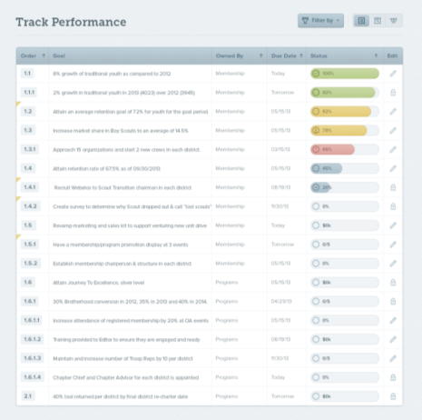
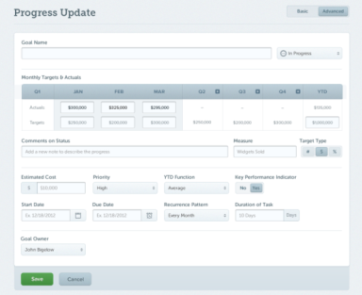
Streamlined Progress Updating
Track your performance to show only necessary status information.
High priority items are flagged.
Click on the pencil to update the progress on one page – including dates, priority and ownership.
Notes:
“Let’s first orient ourselves to the layout of the performance section, and then we’ll jump in to see how we actually make a progress update.
There are a couple of different pages in the Performance Section, but we want to look at the Track Performance page.
When you navigate to the Track Performance section, you’ll notice that it will only populate with goals that you’ve been assigned to, goals that are supporting yours, or goals that you’re working to support.
You’ll also notice that you have pencil icons next to goals that you’re permitted to edit, and lock icons next to those that you’re not. If you need to filter through to find a certain goal or set of goals, you can use the filter feature in the upper, right-hand corner.

Slide 17
How to update a goal
Click on the pencil icon next to the goal you’re wanting to update.
Three steps to updating a goal:
Update your Status
Update your Actual
Leave a Comment (if needed)
Click “Save,” you’re finished!
Notes:
“To update a goal, click on the pencil icon to the right of the goal description. If there is a “lock” icon there, it’s because you’re not permitted to make changes to that goal.
Once you’re in the goal, think about the update process in 3 steps:
First, update your status using the dropdown menu in the upper, right-hand corner. Note that this is updated independently of the actual metric update that you’ll make, so be sure to not miss it.
Next, update your actual for the most recent time period. For example, I’d update my actual progress or performance for the previous week or month.
Finally, leave any comments that you might have. This is not a necessary step, but if a qualitative narrative is helpful – this is the place to do it. Keep in mind that we want to track comments in reverse order and we want to start each one with both the date and our initials so the most relevant comments are on top, and we know who left them. These will also show up on reports, so keep them brief.
Simple as that, you’ve updated a goal. A few other things to note are that you can click the “Expanded” button in the upper, right-hand corner if you need to update any of the goal components, such as the start and end date.
Additionally – clicking “Save” allows you to save your update and stay on the page, whereas “Save & Continue” will save your update and drop you back on the main Track Performance page.
The following video will walk us through this.”

Slide 18
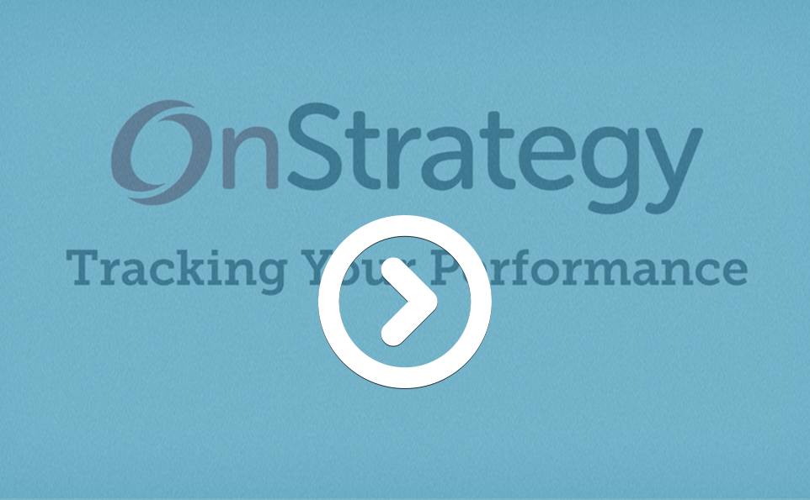
Track Performance
Notes:
Play video here.

Slide 19
Getting the Mobile App
Go to your device’s app store and search for “OnStrategy”
Notes:
An even simpler, faster way of updating goals is with the OnStrategy Mobile Application. You can download this on both Apple and Android, and it’s included with our subscription of OnStrategy.
Keep in mind, when searching for the app in the App Store or Google Play, search for “OnStrategy,” as all one word.
As soon as you download the app, you’ll be able to log in with the same username and password that you’ll be given for the desktop application. Also, absolutely be sure to turn on the push notifications – they’ll help you to remember when you need to update your goals.

Slide 20
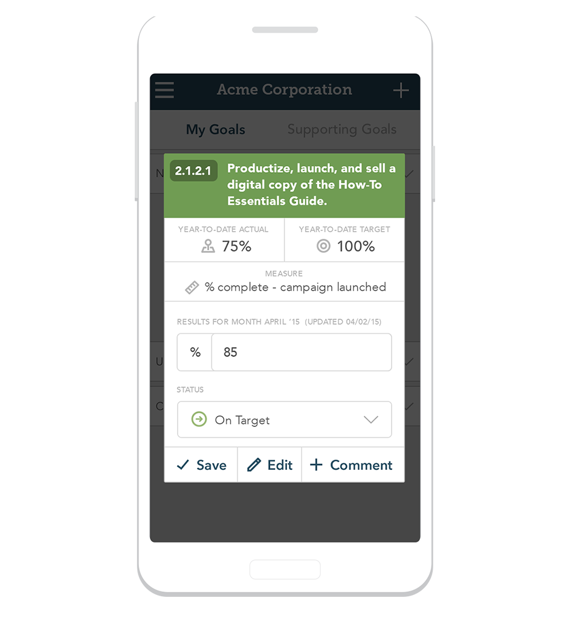
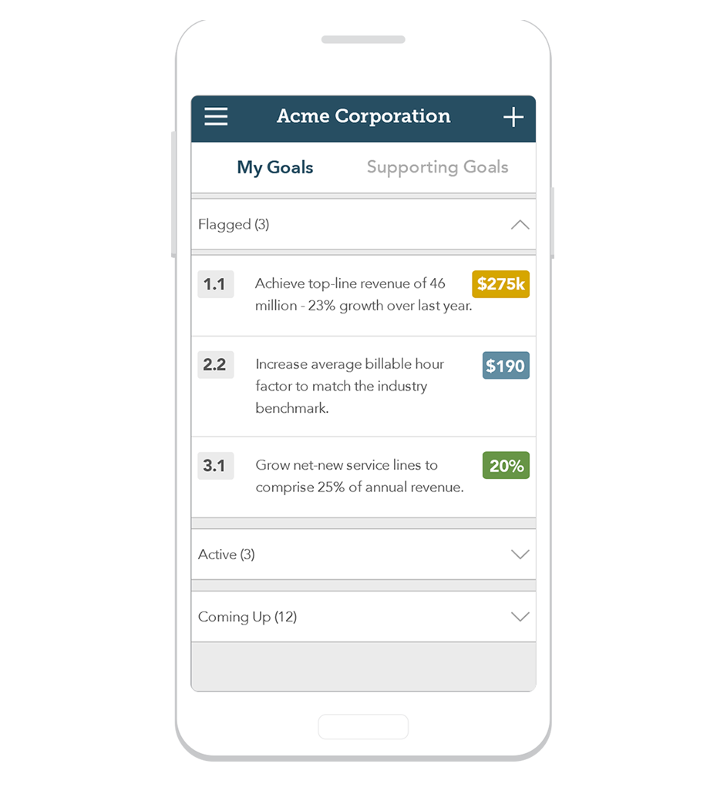
STAY FOCUSED WITH ONSTRATEGY MOBILE
Priorities in your pocket show you what needs your focus.
Manage performance in 30 seconds using the quick update screen.
Know what is on your horizon by seeing goals that are coming up within 90 days.
Notes:
The Home Page Overview allows you to keep your priorities top of mind.
Flagged Goals - alert you to when it’s time to focus on certain goals, or when those goals need updating.
Active Goals - are the items that may not need your immediate attention, but you should be actively monitoring.
Coming Up – this section allows you to see the goals that are on your horizon.
To update a goal, simply tap anywhere on the goal and follow the same three steps that we discussed when looking at the Track Performance section.
You’ll have these same sections in the “Supporting Goals” section, so that you’re able to look at those items that are supporting the goals that you’re responsible for.

Slide 21
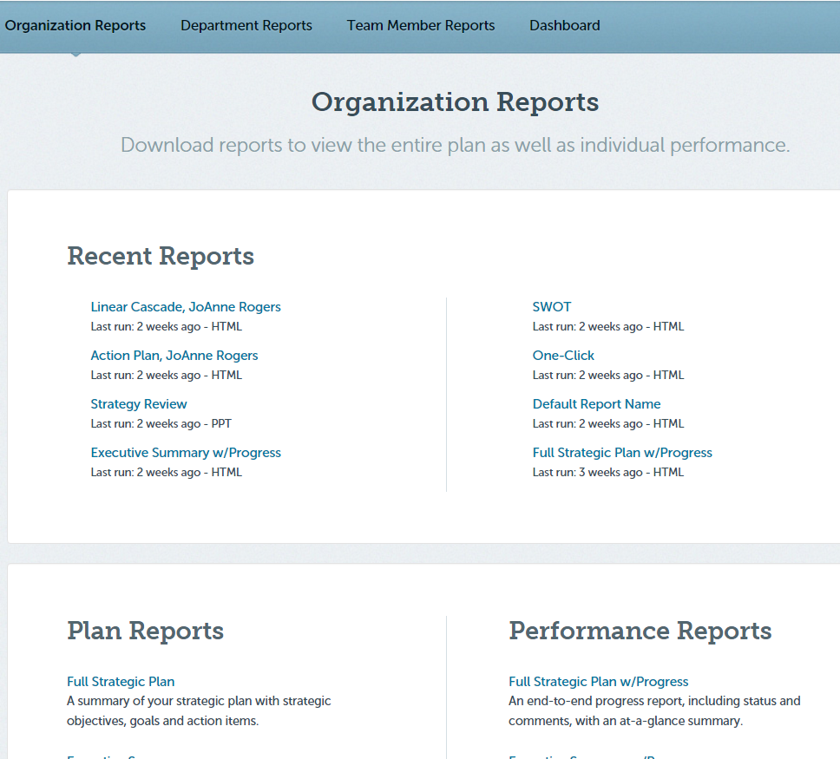
OnStrategy Reporting Features
Notes:
Now that you understand how we’re going to finish building our plan in the system and continue to update it throughout the year, let’s look at how the Reports section works, and how it’s going to save us time and help us have better visibility into our progress against plan.
If you navigate to the “Reports” section in the main navigation, you’ll see the various sub-categories, including Organization and Team Member Reports as well as the Dashboard.
Within the Organization and Team Member Reports Sections, there are both Plan and Performance Reports. Plan reports communicate what the plan is. Performance reports communicate what the plan is and how we as a team are performing against it. Reports can be downloaded right to a PDF, or Word, or right in your browser with HTML.
There are a variety of different reports, each purposed differently, so take some time to explore and familiarize yourself with each. We’ll likely standardize a few that we will use on a regular basis. Also, note that you’re able to pull reports specific to departments and team members. You’ll find it really useful after you enter your goals to navigate to the Team Member Reports Section and download your individual Action Plan, which will outline everything in the plan that you’ve been assigned to.

Slide 22
Visual Performance Dashboard
Save custom dashboards and share with anyone
Quick, dynamic visual overview of current goal/action performance
Filter and sort by organizational function, status and priority
Detailed view of performance by month, quarter and YTD
Notes:
The Dashboard is different in that it’s a dynamic report, rather than a downloadable report. It displays chips that represents the different goals in our plan and the performance against those goals in graphical form. You can also filter through the Dashboard to narrow the scope to just those goals that you’re wanting to review. We’ll use the Dashboard to facilitate our strategy review meetings, so you can see why making sure that you’re updating your progress against plan on a regular basis will be critical to our success in this process.

Slide 23
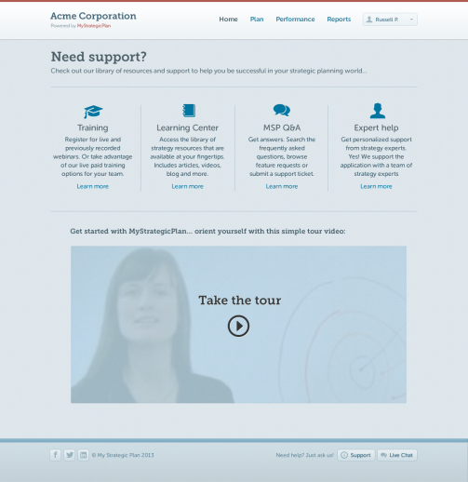
Support
Self-help resources: Use our convenient FAQs and Web based tutorial to learn tips and tricks to make planning easier.
Dedicated Strategy Advisor: We have expert strategists on hand to help you create and execute great strategy.
Unlimited technical support: Use live chat to get instant answers to your technical questions.
Notes:
“Remember, there are a lot of resources in the OnStrategy system to help you be successful. I’ll be sending you a CheatSheet after this training to help you with the initial steps, but when you’re logged in, remember both the More Info section in the upper, right-hand corner of many pages in the platform, as well as the Live Chat feature in bottom, right-hand corner of all pages within the platform. For questions regarding our strategy, contact me.”

Slide 24
Contact Information
OnStrategy
465 Court Street
Reno, Nevada 89501
(775) 747-7407 ph
admin@OnStrategyHQ.com
Our office hours are Mon-Fri 9am-5pm (PT).

