Slide 1
The Scout-Driven BSA Introducing the Voice of the Scout Summer 2011

Slide 2
Agenda & Overview
What is Voice of the Scout (VOS)
Introduction to the Net Promoter
Preliminary VOS Results
Using VOS as a Management Tool
VOS & the Journey to Excellence
Getting Ready for VOS
Online? Watch the 3 min VOS overview video from this year’s Top Hands!
(Click on the image to launch YouTube.)
2

Slide 3
What is the Voice of the Scout?
Comprehensive Scout, Parent, Volunteer and Charter Org feedback program
System to continuously assess how well we are delivering the Scouting experience over time
Insight for change comes from the end user
Based on Net Promoter Score* methodology
18th Journey to Excellence criteria
*The Net Promoter is a registered trademark of Satmetrix, Bain & Company, and Fred Reichheld.
Notes:
Coming in 2012, the Boy Scouts of America will launch the first comprehensive feedback system for connecting to our customers called the Voice of the Scout. It is modeled after the Net Promoter Score, a vastly successful system for Growth & Retention of customers.
Key Point: BSA launching a comprehensive Scouter feedback program. In fact, it is called…”The Voice of the Scout (VOS)”. Our goal is to become more Scouter driven in all that we do.

Slide 4
Scout & Volunteer Retention
Scout & Volunteer Referrals
Membership Growth
END RESULT: Youth Market Share Growth
Program Satisfaction
What is VOS Success?
To be Scout driven in all that we do.
Notes:
Key Point: Benefits your membership growth, referral, youth market share, scout and volunteer retention and recruitment, and overall program satisfaction

Slide 5
Who is the Voice of the Scout?
Parents Boy Scout & Cub Scout Parents
Youth Boy Scouts, Venturers, & Cub Scouts (via Parents)
Volunteers Youth-facing & Council/District Volunteers
Chartered Organizations
Notes:
The Voice of the Scout will continuously collect experiences of
seven segment audiences, with no one individual receiving surveys more than once every 6 months.
All surveys are specially designed for each audience group and will measure
LOYALTY and tailored DRIVERS of LOYALTY
for these customers of the Boy Scouts of America.

Slide 6
Your VOS Working Teams
Mission Impact: Leading the initiative and is the VOS Program owner at the National Council. (Mike Watkins – VOS Program Manager; Patty Bowman - VOS Administrator)
M3 Planning: Expert Research Firm guiding the development and deployment of the NPS system as well as providing external, objective analysis. (Erica Olsen, VOS Project Manager; Cammy LoRe, Communications/Training Lead; Howard Olsen, VOS Market Research Architect)
BSA Research & Evaluation: Providing research expertise and analysis as well as monitoring and ongoing evaluation of the program. (Pat Wellen, Innovation & Research Director)
BSA IT: Building the VOS system and supporting dashboard. (Al Landon, IDG Lead; Jan Haase, Business Analyst)
Notes:
Key Point: M3 Planning is our Expert research firm

Slide 7
Your VOS Guiding Coalition
VOS Guiding Coalition: Guiding the strategy development and deployment of VOS
David Weekley, Southern Region President and VOS Project Chairman
Jim Rogers, National Mission Impact Committee Chair
Les Baron, Scout Executive National Capital Area Council – Bethesda, MD
Rick Williamson, Western Region Deputy Regional Director
Jason Stein, Scout Executive Santa Clara County Council – San Jose, CA
Burke Powers, Assistant Scoutmaster, IBM Voice of the Customer program manager
Craig Poland, Scout Executive Minsi Trails Council – Lehigh Valley, PA
Tom Harrington, Scout Executive Cradle of Liberty Council – Philadelphia, PA

Slide 8
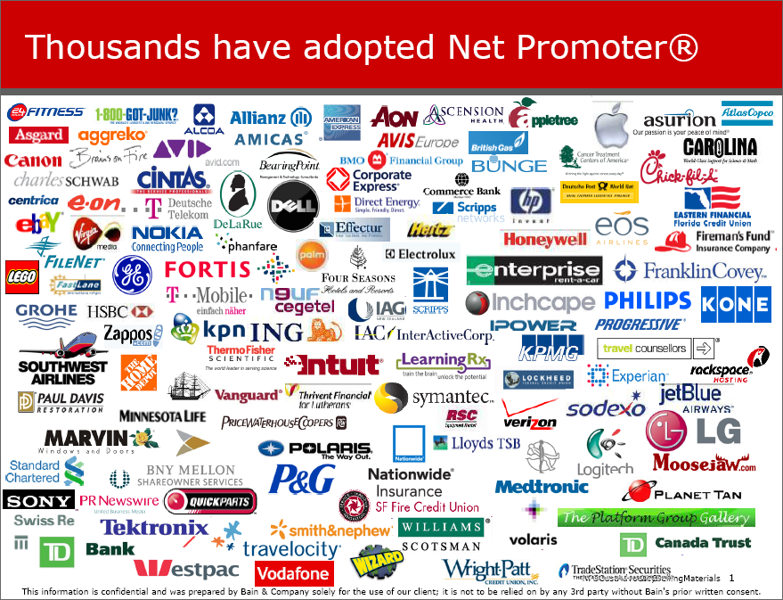
Thousands use NPS to Drive Growth
Siemens IT: Identifies at-risk
accounts, proactively addresses
concerns resulting in revenue gains
tw telecom: Reduced customer turnover by 27% in 2 years
1-800-Got-Junk: Went from $1M
to $119M in sales in 7 years
HP: Vendor performance rating increased 15%
Zappos: Uses NPS every day
*Examples and testimony given at
the 2011 Net Promoter Score conference,
Miami, Florida and Satmetrix Case Studies.
Notes:
Key Point: Net Promoter Score (NPS) is a proven and easy to understand research process to determine customer satisfaction and willingness to promote a service/product to others.
Tw telecom: understanding root causes of what isn’t working will increase member retention
800 Junk: Developing improvements in areas that resonate with members & leaders will increase growth
HP: Grass roots information will help councils drive their improvements, their way
Siemens: ID critical breakdowns in member & volunteer relationships and repair to prevent as exit from Scouting
Zappos: Leaders always listen: ie Colin Powell, the day you stop hearing from soldiers is the day you stop being a leader.

Slide 9
The one question you need to know
How likely is it that you would recommend the Scouting program to other families and friends with Scout-aged boys?
When members and volunteers recommend other people to BSA, they’re putting their reputation on the line.
They will only take that risk if
they are loyal.

Slide 10
Making it Easy to Take Action
Protect and increase experiences that create enthusiastic, loyal customers or “promoters”.
Decrease experiences that lead to disenfranchised, disappointed customers or “detractors”.

Slide 11
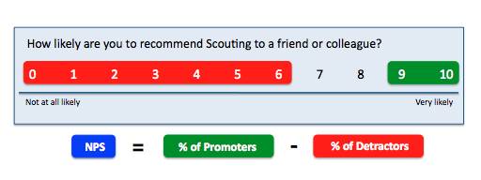
Net Promoter Score: Basic Components
Promoters (score 9–10) Loyal enthusiasts who will keep referring others and fuel growth.
Passives (score 7–8) Satisfied but unenthusiastic customers vulnerable to leaving to dedicating their time to something else.
Detractors (score 0–6) Unhappy customers who can impede growth through
negative word-of-mouth, damaging the Boy Scout brand.
Notes:
If you have 1 response and the NPS rating was: 9 or 10, then your NPS would be 100: 7 or 8, then your NPS would be 0: 0-6, then your NPS would be -100.

Slide 12
CUSTOMERS
Why use Net Promoter Score?
Proven methodology
Easy to use & understand
Easy to communicate
Action oriented
Simple for respondent
1 Loyalty Question
7 Driver Questions
Open comments
Loyalty (NPS)
Driver
Driver
Driver
Driver
Driver
Driver
Driver
Notes:
EASY TO MEASURE: By focusing on one question that defines what a loyal customer is, it streamlines the way results can be delivered.
EASY TO COMMUNICATE: Responses are placed into three responder groups that that we will introduce in the next slide.
ACTION-ORIENTED: Seeing metrics and trends within the three responder categories offers clarity for leaders, directors and executives to develop and track solutions to move people away from being detractors and into being promoters.
CUSTOMER-FOCUSED: Improvement becomes directed to what actually matters to the customer, which keeps attention on the right stuff! Experiences that are exceptionally good or bad will get the spotlight deserved.
12

Slide 13
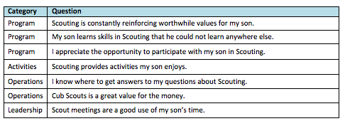
NPS + DRIVERS = Voice of the Scout
Driver questions have been statistically validated so we understand
What drives loyalty for each audience segment.*
Cub Scout Parents
Driver Questions Sample –
Specific to each customer segment
*Based on preliminary independent research
done in Spring/Summer 2011
Notes:
Key Point: Seven Questions are also being asked to help explain the answers associated with the Net Promoter Score (NPS) results.
The most successful NPS programs supplement surveys with a
small number of questions to help understand what drives
value for their customers. For the Voice of the Scout, driver
questions have been developed to help verify experiences
members and volunteer leaders in key areas: Programs, Leadership, Activities & Operations.

Slide 14
Overview of Preliminary Results
Net Promoter Score by Segment
Cubs Scouts Boy Scouts Venturers Cubs Scout Parents Youth Facing District/Council Charter Orgs. Boy Scout Parents
35%
41%
45%
51%
51%
63%
65%
68%
0% 10% 20% 30% 40% 50% 60% 70% 80% 90% 100%
Net Promoter Score data for the above segments was gathered from May through July 2011 with about 25,000 total respondents.
Data were collected via nationwide pretest as well as through 8 pilot councils: Alamo Area, Coronado Area, Dan Beard, Minsi Trails, Montana, National Capitol, Santa Clara, and Mecklenburg County.

Slide 15
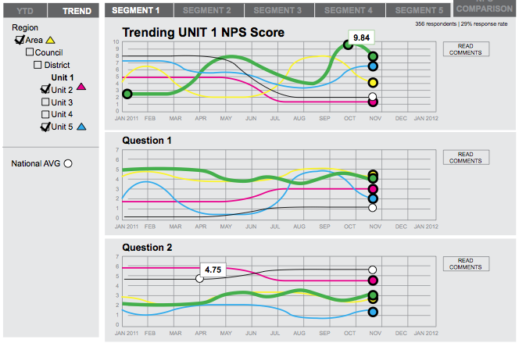
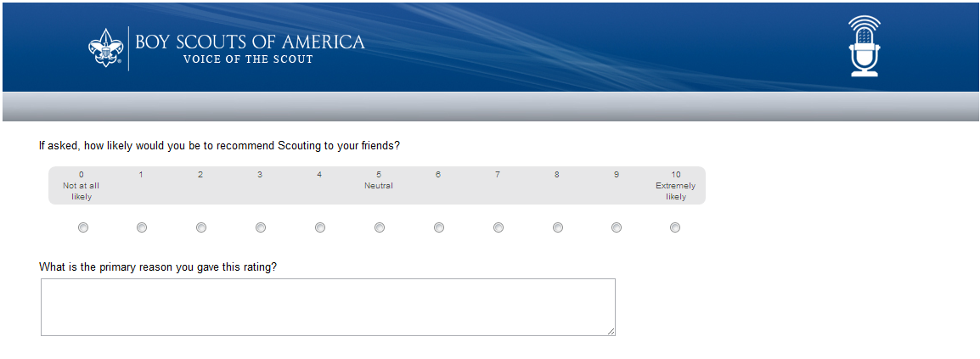
Using VOS as a Management Tool
GATHER
COMMUNICATE
RESPOND
Take action
Tell respondents about action taken
Measure results
Email invitations sent
to people at maximum once every six months.
Automatically view results in the VOS Dashboard.
Monthly reports and notices emailed directly to SEs.
Report on results and action at Staff, Commissioner and Board Meetings, Roundtables, etc.
Notes:
Feedback success begins with accurate emails & unit outreach.
Survey responses are critical but
not the only component of VOS.
Continuous updates through an online dashboard with automated
reports will keep you connected to what your members and volunteers feel about Scouting.
This is bigger than any number or score: Feedback is insight with the power to drive a better experience for kids. Rely on this for guiding decisions & actions.

Slide 16
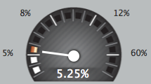
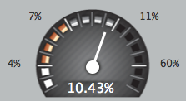
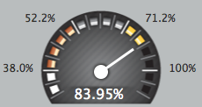
Council Journey to Excellence in 2012
Council VOS= JTE Bonus points in 2012.
Bronze – 25 pts
Silver – 50 pts
Gold – 200 pts
Opt In & On Boarding
Email Address Saturation
Net Promoter Score
Commit to participate in the Voice of the Scout program and attend on-boarding training. | Achieve bronze requirements and have 60% of all registrants (youth and adults) with email addresses in ScoutNet. | Achieve silver requirements and achieve an overall average Net Promoter Score of 45%.
Notes:
Key Message: In 2012 Voice of the Scout results will be a bonus opportunity for Journey to Excellence scores.
Specifics on how VOS will be weighed will be determined by Mission Impact at the end of July and will be announced at Top Hands.

Slide 17
District Journey to Excellence in 2012
District VOS= JTE Bonus points in 2012.
Bronze – 25 pts
Silver – 50 pts
Gold – 200 pts
Email Address Saturation
Response Rate
Net Promoter Score
Have 60% of all registrants (youth over 13 and adults) with email addresses in ScoutNET. | Achieve bronze requirements and have 15% of those surveyed actually respond. | Achieve silver requirements and achieve an overall average Net Promoter Score of 45%.
Notes:
Key Message: In 2012 Voice of the Scout results will be a bonus opportunity for Journey to Excellence scores.
Specifics on how VOS will be weighed will be determined by Mission Impact at the end of July and will be announced at Top Hands.

Slide 18
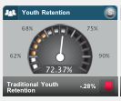
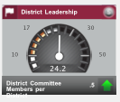
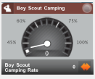
How VOS Drives Results
Examples of other ways VOS will enhance JTE
Increases in the Detractor category could be a leading indicator
of a reduced Youth Retention and decreasing Membership.
Increases into the Promoter category for the District/Council Volunteer audience could be a leading indicator to see an increase in District’s Leadership numbers.
Increases in increases in percentage of youth attending camp, coupled with a corresponding increase in Promoter numbers could be a leading indicator of Boy Scout Camping increases.

Slide 19
Ready to Listen? OPT-IN!
The Opt-In Process is offered to give councils control over when they enter into the Voice of the Scout program. Two Opt-In cycles are available in the Fall & Spring. It’s the only way to get bonus points AND a jump on the what works in this program before it becomes national in 2013.
2011 Fall
2012 Spring
Sept thru Oct Declare interest via email
at jte@scouting.org
Oct thru Nov Attend trainings via webinar or schedule a recorded session.
By Nov. 18 Confirm participation
Jan 2012 Surveys launched
May Declare interest via email
at jte@scouting.org
June thru July Attend trainings via webinar or schedule a recorded session.
By July 15 Confirm participation
August 2012 Surveys launched

Slide 20
Next Steps for Councils
Opt into the Voice of the Scout Program – get on-boarding and training to your Council Key 3 – when you are ready between now and Dec. 2012. Opt-in to the VOS Program administrator at JTE@scouting.org.
Make email fields required on registration by directly asking at every registration, event sign-up, school night sheet and anywhere else that you would normally ask for a name & number. (Scouts under 13 exempt)
Train your registrars on the critical importance of updating the system within the week at the very latest with new emails.
Choose a VOS leader on your staff who is capable of listening & inspired to serve Scouts to be your champion for this program.

Slide 21
Contact Info & Resources
Voice of the Scout Program Manager: Mike Watkins, Mission Impact, mike.watkins@scouting.org
Voice of the Scout Program Administrator: JTE@scouting.org
Download the VOS Council Toolkit and additional resources including videos, articles and guides are located at:
http://www.scouting.org/scoutsource/Awards/JourneyToExcellence.aspx
Top Hands Overview Video (3 mins): http://www.youtube.com/watch?v=C82fYu23_Ho&feature=digest_social

