Slide 1
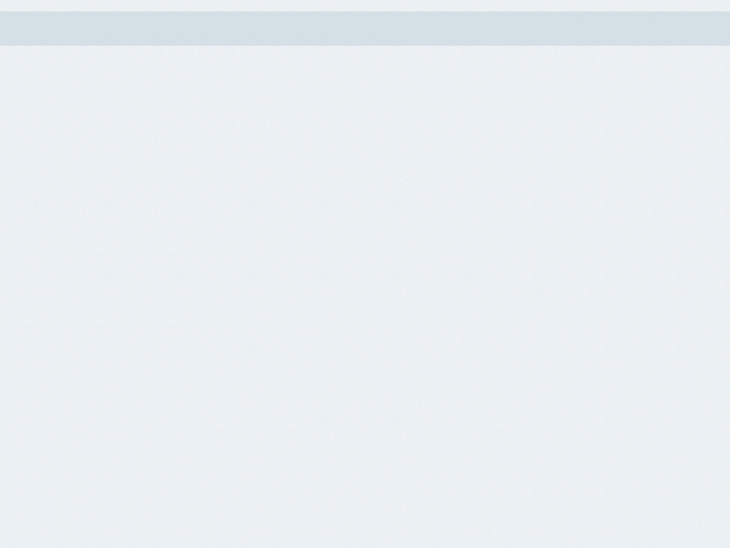
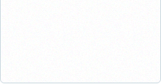

Acme Corporation Technology
Acme Corporation Technology
Strategy Review Meeting
Strategy Review Meeting
12/03/2013
12/03/2013

Slide 2
AGENDA
AGENDA
I. Acme Corporation Technology Overview / Performance II. Department Review - Department Performance / Scorecard III. Strategic Topics / Deep Dive IV. Wrap-Up and Next Steps
1

Slide 3
AGENDA - ORDER OF PRESENTATION
AGENDA - ORDER OF PRESENTATION
Ann Smith
Administration: JoAnne Rogers
Customer Service: Mikey Hougland
IT Group: Nate Platt
Public Policy: Public Policy
Sales/Marketing: Sales / Marketing VP
Web Specialists: Greg Smart
2

Slide 4





OVERALL - PERFORMANCE TO DATE
OVERALL - PERFORMANCE TO DATE
ORGANIZATION GOALS
1.1 Generate sales of $1 million by the end of the year. (Source:Quick Books) (Administration)
September $100,000 / $105,000 October $100,000 / $99,000 November $100,000 / $25,000
$969,000
$969,000
Measure: $ in sales Target: $1,000,000
2.1 Maintain a 20% profit margin in 2013. (Administration)
25%
25%
Measure: % Complete Target: 100%
2.2 Maintain profitability with a budget allocation of 50% for business re-investment for product development. (Administration)
30%
30%
Measure: % for product development Target: 50%
3

Slide 5

OVERALL - PERFORMANCE TO DATE
OVERALL - PERFORMANCE TO DATE
ORGANIZATION GOALS
2.3 Increase average billable hour factor. (Source: Time-tracking Program) (Administration)
September $160 / $155 October $175 / November $180 /
$125.56
$125.56
Measure: $ per billable hour. Target: $200
3.1 Licensing: Acquire 1,000 total licenses by the end of the year. (Operations)
September 700 / October 800 / November 900 /
580
580
Measure: # of new licenses Target: 1,000
3.2 Develop understanding of technological issues had by existing customers. (IT Group)
September 75% / 75% October 75% / 75%
75%
75%
Measure: % complete Target: 100%
4

Slide 6

OVERALL - PERFORMANCE TO DATE
OVERALL - PERFORMANCE TO DATE
ORGANIZATION GOALS
4.1 Maintenance Contracts: Acquire an average of 5 new maintenance contracts per month (Sales/Marketing)
September 5 / October 5 / November 5 /
3.75
3.75
Measure: avg monthly # of new maintenance contracts Target: 5
4.2 Maintain 75% of our current customers. (Customer Service)
85%
85%
Measure: % increase in customer base annually Target: 85%
5.1 Professional Service: Acquire 2 new consulting clients $10,000+ per month. (Sales/Marketing)
33
33
Measure: # of new consulting clients Target: 24
5

Slide 7





OVERALL - PERFORMANCE TO DATE
OVERALL - PERFORMANCE TO DATE
ORGANIZATION GOALS
6.1 Attract: Increase the overall traffic to website by 25% from 2012 by comparing against the same month of the previou... (Web Specialists)
September 170,000 / October 173,000 / November 175,000 /
165,000
165,000
Measure: Total visits Target: 181,250
6.2 Acquire: Increase rate of visit to lead from .41% to 1%. (Web Specialists)
0%
0%
Measure: % visits to lead Target: 1%
6.3 Convert: Increase the number of leads who become customers from 20% to 25%. (Web Specialists)
10%
10%
Measure: # of leads who become custoemrs (Performable) Target: 25%
6

Slide 8

OVERALL - PERFORMANCE TO DATE
OVERALL - PERFORMANCE TO DATE
ORGANIZATION GOALS
7.1 Launch integration with 2 other applications (IT Group)
100%
100%
Measure: % complete Target: 100%
7.2 Complete and launch the API (IT Group)
20%
20%
Measure: % complete Target: 100%
8.1 Set up computers to be accessed from any destination. (Administration)
100
100
Measure: # of computers set up each year Target: 5
7

Slide 9

OVERALL - PERFORMANCE TO DATE
OVERALL - PERFORMANCE TO DATE
ORGANIZATION GOALS
8.2 Define all procedures and process in writing in order to support projected growth. (Administration)
50%
50%
Measure: % of process in writing. Target: 100%
8.3 Blogs & Newsletters: Consistently timely relevant thought leadership that is developed, published and preserved. (Sales/Marketing)
33
33
Measure: % complete Target: 100
9.1 Train sales people in best practices (Sales/Marketing)
25
25
Measure: actual attendance per year by all 12 managers Target: 12
8

Slide 10
OVERALL - PERFORMANCE TO DATE
OVERALL - PERFORMANCE TO DATE
ORGANIZATION GOALS
9.2 Develop better communication and presentation skills to increase ability to work with and assist clients. (Customer Service)
0%
0%
Measure: % complete in communication/presentation skills Target: 100%
10.1 Manage the selection, contribution and customer communication of nonprofit donations. Target is 15% of revenue. (Administration)
35%
35%
Measure: % of license revenue Target: 15%
11.1 Organizational Goal (Corporate-wide, generally not assigned, 18-24 months) [**Sample Goal Cascading**] (Operations)
0%
0%
Measure: % complete Target: 100%
9

Slide 11
Administration
JoAnne Rogers
10

Slide 12

ADMINISTRATION - PERFORMANCE TO DATE
ADMINISTRATION - PERFORMANCE TO DATE
DEPARTMENT GOALS
1.1.1 Software Licenses: Generate $300,000
$123,455
$123,455
Measure: $ generated Target: $300,000
2.1.1 Maintain a 20% profit margin in 2013.
0%
0%
Measure: % profit margin Target: 20%
4.2.2 Develop a competitive analysis survey for our market.
114.50%
114.50%
Measure: % Complete Target: 100%
11

Slide 13
ADMINISTRATION - PERFORMANCE TO DATE
ADMINISTRATION - PERFORMANCE TO DATE
DEPARTMENT GOALS
8.3.2 Write 2 newsletters per month.
1.80
1.80
Measure: # of newsletters Target: 2
12

Slide 14
Customer Service
Mikey Hougland
13

Slide 15

CUSTOMER SERVICE - PERFORMANCE TO DATE
CUSTOMER SERVICE - PERFORMANCE TO DATE
DEPARTMENT GOALS
1.1.3 Professional Consulting: Generate $200,000 in web design consulting
25,000
25,000
Measure: $ Target: 200,000
3.1.4 Maintain or decrease the Churn Rate of Licenses which is currently at 8.5%.
8.40%
8.40%
Measure: % Churn Target: 8.49%
14

Slide 16
IT Group
Nate Platt
15

Slide 17

IT GROUP - PERFORMANCE TO DATE
IT GROUP - PERFORMANCE TO DATE
DEPARTMENT GOALS
3.1.1 Grow average monthly licenses by 40% to 427
385
385
Measure: # Licenses Target: 427
3.1.2 Grow new customer conversions by 100% to an average of 60/month.
30
30
Measure: # of new licenses Target: 60
3.1.3 Grow new customer trials by 25% to mark of 75 New Trials per month.
51
51
Measure: # of New Trials Target: 75
16

Slide 18
IT GROUP - PERFORMANCE TO DATE
IT GROUP - PERFORMANCE TO DATE
DEPARTMENT GOALS
8.1.1 Purchase necessary software/hardware or make arrangements with an internet service provider fo...
55%
55%
Measure: % complete Target: 100%
9.1.1 Test Goal #1- Develop a program to track the training
0%
0%
Measure: % of program completed Target: 100%
17

Slide 19
Public Policy
Public Policy
18

Slide 20
PUBLIC POLICY - PERFORMANCE TO DATE
PUBLIC POLICY - PERFORMANCE TO DATE
DEPARTMENT GOALS
11.1.1 Department Goal [Corporate Action Item] (Assigned to the Department responsible for seeing t...
$60
$60
Measure: $ Target: $5,000
19

Slide 21
Sales/Marketing
Sales / Marketing VP
20

Slide 22
SALES/MARKETING - PERFORMANCE TO DATE
SALES/MARKETING - PERFORMANCE TO DATE
DEPARTMENT GOALS
1.1.2 Maintenance Contracts: Generate $500,000 in maintenance contracts
$50,000
$50,000
Measure: $ Target: $500,000
4.1.1 Identify and maintain list of 50 target customers that could benefit from a maintenance contra
50%
50%
Measure: % Complete Target: 100%
4.2.1 Implement marketing campaign to draw in new markets.
60%
60%
Measure: % completed Target: 100%
21

Slide 23
SALES/MARKETING - PERFORMANCE TO DATE
SALES/MARKETING - PERFORMANCE TO DATE
DEPARTMENT GOALS
4.2.3 Increase sales close rate by 25%
15%
15%
Measure: % increase in close rate Target: 25%
22

Slide 24
Web Specialists
Greg Smart
23

Slide 25
WEB SPECIALISTS - PERFORMANCE TO DATE
WEB SPECIALISTS - PERFORMANCE TO DATE
DEPARTMENT GOALS
6.1.1 Web site: Update Google AdWords, home page and landing pages on a quarterly basis.
85%
85%
Measure: % Complete Target: 100%
7.1.1 Map out entire integration process
15%
15%
Measure: Map completed Target: 100%
8.3.1 Write 1 blog post per week
20
20
Measure: # of blog posts Target: 52
24

Slide 26
WRAP-UP AND NEXT STEPS
WRAP-UP AND NEXT STEPS
I. What needs to be done in response to this meeting? II. What responsibilities do each of us have to keep the strategic plan moving forward? III. What is the date of our next Strategy Review Meeting?
25

