Slide 1
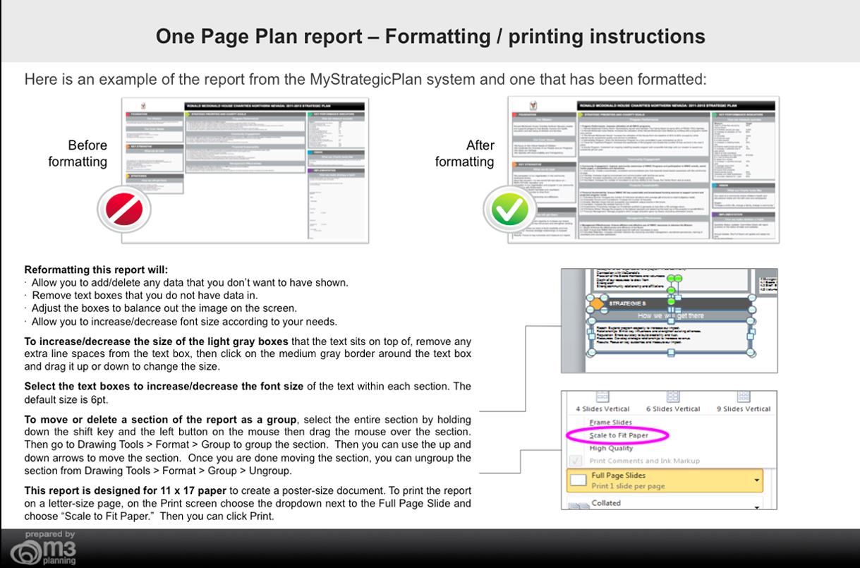

Slide 2

ACME CORPORATION TECHNOLOGY: STRATEGIC PLAN
FOUNDATION
OBJECTIVES AND ORGANIZATION GOALS
KEY PERFORMANCE INDICATORS
Our Mission
Financial
How we measure success
The mission of Acme Corporation Technology is to create technology solutions for forward-thinking organizations.
Measure
$ in sales
$ per billable hour.
# of new licenses
# of new maintenance contracts
% complete
Total visits
Target
$1,000,000
$200
1,000
5
100%
174,000
1 Revenue Growth: Grow our revenue by 30% each year 1.1 Generate sales of $1 million by the end of the year. (Source:Quick Books) 1.2 Increase average billable hour factor. (Source: Time-tracking Program)
2 Productivity Improvement: Maintain a 20% Net Profit Margin 2.1 Maintain profitability with a budget allocation of 50% for business re-investment for product development. 2.2 Maintain profitability with a budget allocation of 25% for cash reserves. 2.3 Maintain profitability with a budget allocation of 25% for profit sharing
Our Core Values
Purpose & Growth - our foundation is built on our purpose and provides a place for our team's passion Client Focus - a razor-sharp focus on our customer's growth is essential and the only way to succeed. Integrity - to have honesty and respect for all individuals. Leadership - to empower and inspire entrepreneurial leaders. Professionalism - to be professional in our actions to our clients, partners and each other. Excellence - to continually pursue knowledge and learn. Community Service - to effectively help organizations to make an impact. Fun - to have enjoyment and fulfillment in our work.
Programs/Services
3 Current Customers: To be viewed as the valued and effective technology resource in the western region 3.1 Licensing: Acquire 1,000 total licenses by the end of the year. Eor 3.2 Maintenance Contracts: Acquire an average of 5 new maintenance contracts per month 3.3 Provide new service packages to help clients achieve more success. 3.4 Develop understanding of technological issues had by existing customers.
4 New Customers: Increase new customer base by being viewed as the professional partner of choice. 4.1 Reach a 15% annual increase in new customers over the next 2 years. 4.2 Professional Service: Acquire 3 new consulting clients (of $5K+) per month.
COMPETITIVE ADVANTAGES
Internal Operations
VISION
What we do best
5 Administrative Operations: Develop and maintain an infrastructure that allows for a virtual office and efficient overhead. 5.1 Set up computers to be accessed from any destination. 5.2 Define all procedures and process in writing in order to support projected growth.
6 Sales/Marketing: Consistently communicate our value proposition across all mediums and increase awareness of our organization. 6.1 Attract: Increase the overall traffic to website by 20% (ended 2011 at 145,000 monthly unique visits). 6.2 Convert: Increase the number of leads who become customers from 20% to 25%. 6.3 Blogs & Newsletters: Consistently timely relevant thought leadership that is developed, published and preserved.
7 Innovation/Product Development: Continue to develop technology innovation. 7.1 Launch integration with 2 other applications 7.2 Complete and launch the API 7.3 Launch a mobile app (ipad & iphone).
What our Organization looks like
Reoccurring revenue that is scalable
Assets and software products in place outside our services
Innovative in marrying business process with technology
Business Network - domestic and international
Patented Intellectual Property - interactive, integrated web-based
To be known as the technology experts and resource center for small to medium-sized organizations.
IMPLEMENTATION
How we make strategy a habit
MAJOR EMPHASIS IN 2013
People/Leadership
Appoint a strategic plan manager
Hold people accountable (now that they are able)
Put in place an incentive compensation plan
Coach for achievement
Empower managers
Hold effective strategy meetings - first Mondays
Hold annual retreat - second week in December
How we will get there
8 Training: Actively help our team to develop and grow professional and personally by supporting a flexible work life, providing intellectually engaging work, and fair compensation. 8.1 Create technology library and resource center 8.2 Train sales people in best practices 8.3 Develop better communication and presentation skills to increase ability to work with and assist clients.
9 Culture: To align incentives and employee rewards with staff performance. 9.1 Increase the number of innovative ideas through an incentive program.
10 Community Involvement: Develop and implement a corporate giving strategy that is in line with our competitive advantages. 10.1 Manage the selection, contribution and customer communication of nonprofit donations. Target is 15% of revenue.
11 Long Term Strategic Objective (No assignment, far reaching and broad based, 3-5 years out) [**Sample Goal Cascading**] 11.1 Organizational Goal (Corporate-wide, generally not assigned, 18-24 months) [**Sample Goal Cascading**]
Organization-Wide Focus: 2010 - Lay the foundation for the organization. 2011 - Execute a market penetration strategy to increase top line. 2012 - Standardization of all processes. 2013 - Develop the infrastructure to prepare for high growth. Organization's Focus for 2012: - Low Cost Provider - Customer Intimacy - Product Leadership

