Slide 1
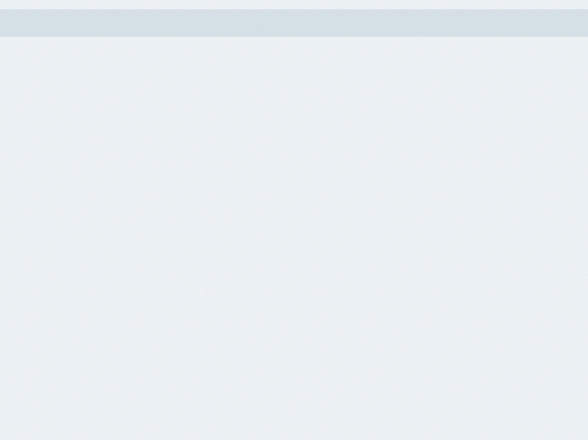
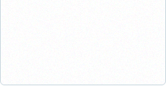

Acme Corporation
Acme Corporation
Strategy Review Meeting
Strategy Review Meeting
For FY16
For FY16

Slide 2







AGENDA
AGENDA
I. Acme Corporation Overview / Performance II. Department Review - Department Performance / Scorecard III. Strategic Topics / Deep Dive IV. Wrap-Up and Next Steps
Not Started
Deferred
On Target
Off Target
Waiting
Critical
Achieved
1

Slide 3
AGENDA - ORDER OF PRESENTATION
AGENDA - ORDER OF PRESENTATION
Deb Smith
Administration: JoAnne Rogers
Customer Service: Mikey Hougland
IT Group: Nate Platt
Marketing: Sales / Marketing VP
2

Slide 4




OVERALL - PERFORMANCE TO DATE
OVERALL - PERFORMANCE TO DATE
ORGANIZATION GOALS
1.1 Generate sales of $1.5 million by the end of the year. (Administration)
Jul 2016 $75,000 / $135,000 Aug 2016 $75,000 / $200,000 Sep 2016 $160,000 / $700,000
$1,520,000
$1,520,000
Measure: $ in sales Target: $1,500,000
1.2 Maintain profitability with a budget allocation of 50% for business re-investment for product development. (Administration)
Jul 2016 50% / Aug 2016 50% / 40% Sep 2016 50% / 75%
45%
45%
Measure: % of budget allocated for product development Target: 50%
1.3 Increase average billable hour factor. (Administration)
Jul 2016 $270 / $250 Aug 2016 $270 / $289 Sep 2016 $280 /
$266
$266
Measure: $ per billable hour. Target: $300
3

Slide 5
OVERALL - PERFORMANCE TO DATE
OVERALL - PERFORMANCE TO DATE
ORGANIZATION GOALS
2.1 Professional Service: Acquire 10 new consulting clients at $10,000+ per month. (Administration)
Jul 2016 10 / 8 Aug 2016 10 / 9,000 Sep 2016 10 /
21,014
21,014
Measure: # of new consulting clients Target: 10
2.2 Industry Expertise: Be rated among the Top 10 fastest growing tech companies in 2016. (Marketing)
Aug 2016 10 / 9,000 Sep 2016 10 /
7
7
Measure: Industry ranking Target: 10
3.1 Maintain 85% of our current customers. (Administration)
Jul 2016 83% / 35% Aug 2016 83% / 90% Sep 2016 84% /
90%
90%
Measure: % customer retention Target: 85%
4

Slide 6


OVERALL - PERFORMANCE TO DATE
OVERALL - PERFORMANCE TO DATE
ORGANIZATION GOALS
3.2 Achieve an average of a 9 point satisfaction score on exit surveys. (Customer Service)
Jul 2016 9 / Aug 2016 9 / Sep 2016 9 /
7.67
7.67
Measure: Customer satisfaction score Target: 9
3.3 Licensing: Acquire 3,000 total licenses by the end of the year.
1
1
Measure: # of new licenses Target: 3,000
3.4 Maintenance Contracts: Acquire an average of 7 new maintenance contracts per month
Jul 2016 7 / Aug 2016 7 / Sep 2016 7 /
11.33
11.33
Measure: avg monthly # of new maintenance contracts Target: 7
5

Slide 7



OVERALL - PERFORMANCE TO DATE
OVERALL - PERFORMANCE TO DATE
ORGANIZATION GOALS
4.1 Launch integration with 4 other applications. (IT Group)
Jul 2016 100% / 100%
100%
100%
Measure: Applications Integrated Target: 100%
5.3 Blogs & Newsletters: Consistently timely relevant thought leadership that is developed, published and preserved. (Marketing)
5.33
5.33
Measure: # of pieces published weekly Target: 6
6.1 Train sales people in best practices (Marketing)
Aug 2016 4 /
11
11
Measure: actual attendance per year by all 12 managers Target: 14
6

Slide 8

OVERALL - PERFORMANCE TO DATE
OVERALL - PERFORMANCE TO DATE
ORGANIZATION GOALS
7.1 Manage the selection, contribution and customer communication of nonprofit donations. Target is 15% of revenue. (Administration)
Aug 2016 4% /
2%
2%
Measure: % of license revenue Target: 15%
7

Slide 9
Administration
JoAnne Rogers
8

Slide 10
ADMINISTRATION - PERFORMANCE TO DATE
ADMINISTRATION - PERFORMANCE TO DATE
DEPARTMENT GOALS
1.1.1 Develop our credit card program.
Jul 2016: $10,000 / Actual: Aug 2016: $10,000 / Actual: $8,500 Sep 2016: $20 / Actual: $67,000
$75,500
$75,500
Measure: Gross Revenue Target: $50,000
1.1.2 Software Licenses: Generate $300,000 from added software features by the end of each FY.
Jul 2016: $25,000 / Actual: Aug 2016: $25,000 / Actual: $250 Sep 2016: $25,000 / Actual: $250,000
$605,250
$605,250
Measure: $ generated from added software features Target: $300,000
3.1.2 Develop a competitive analysis survey for our market.
0
0
Measure: % Complete Target:
9

Slide 11
Customer Service
Mikey Hougland
10

Slide 12

CUSTOMER SERVICE - PERFORMANCE TO DATE
CUSTOMER SERVICE - PERFORMANCE TO DATE
DEPARTMENT GOALS
1.1.4 Professional Consulting: Generate $700,000 in web design consulting.
Jul 2016: $59,000 / Actual: Aug 2016: $59,000 / Actual: Sep 2016: $63,000 / Actual: $53,000
$307,000
$307,000
Measure: $ generated from web design consulting Target: $700,000
3.3.4 Maintain or decrease the Churn Rate of Licenses which is currently at 7.99%.
8.01%
8.01%
Measure: % Churn Target: 7.99%
11

Slide 13
IT Group
Nate Platt
12

Slide 14

IT GROUP - PERFORMANCE TO DATE
IT GROUP - PERFORMANCE TO DATE
DEPARTMENT GOALS
2.1.3 Work on new program for....
0
0
Measure: Target: 50%
3.3.1 Grow average monthly licenses by 40% to 840
600
600
Measure: # Licenses Target: 840
3.3.2 Grow new customer conversions by 100% to an average of 78/month.
Jul 2016: 78 / Actual: 85 Aug 2016: 78 / Actual: Sep 2016: 78 / Actual:
78
78
Measure: # of new licenses Target: 78
13

Slide 15

IT GROUP - PERFORMANCE TO DATE
IT GROUP - PERFORMANCE TO DATE
DEPARTMENT GOALS
3.3.3 Grow new customer trials by 25% to mark of 88 New Trials per month.
0
0
Measure: # of New Trials Target: 88
14

Slide 16
Marketing
Sales / Marketing VP
15

Slide 17

MARKETING - PERFORMANCE TO DATE
MARKETING - PERFORMANCE TO DATE
DEPARTMENT GOALS
1.1.3 Maintenance Contracts: Generate $500,000 in maintenance contracts.
Jul 2016: $45,000 / Actual: Aug 2016: $30,000 / Actual: Sep 2016: $60,000 / Actual:
$130,000
$130,000
Measure: $ generated from maintenance contracts Target: $500,000
2.1.1 Develop 2 new webinars a quarter to assist Sales Team.
Sep 2016: 2 / Actual:
0
0
Measure: # of new webinars Target: 8
3.1.3 Increase sales close rate by 25% to achieve a 43% close rate by EOY.
Jul 2016: 41% / Actual: Aug 2016: 41% / Actual: Sep 2016: 42% / Actual:
32%
32%
Measure: Close rate Target: 43%
16

Slide 18
MARKETING - PERFORMANCE TO DATE
MARKETING - PERFORMANCE TO DATE
DEPARTMENT GOALS
3.4.1 Identify and maintain list of 65 target customers that could benefit from a maintenance contract.
0
0
Measure: # of target customers Target: 65
17

Slide 19
WRAP-UP AND NEXT STEPS
WRAP-UP AND NEXT STEPS
I. What needs to be done in response to this meeting? II. What responsibilities do each of us have to keep the strategic plan moving forward? III. What is the date of our next Strategy Review Meeting?
18

